Slide 1
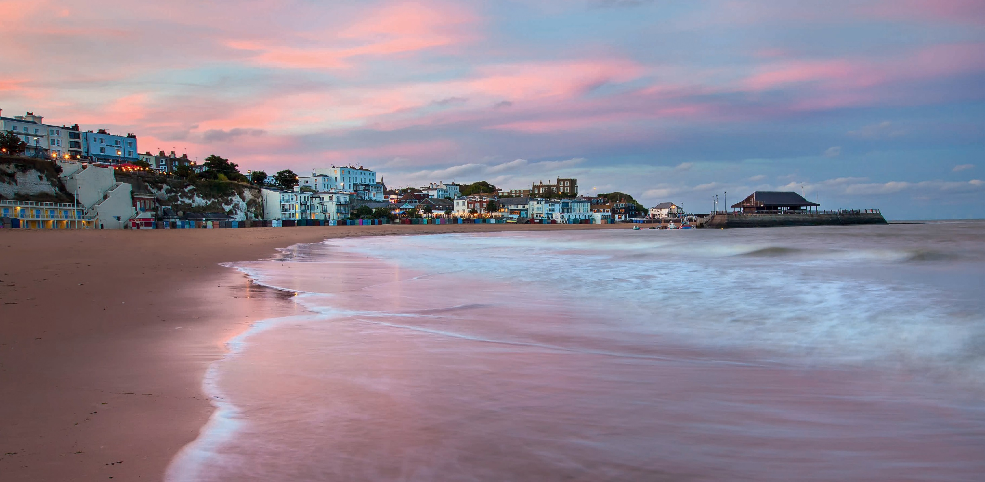
Thanet Visitor Research 2018:
Primary Research Report
April 2019

Slide 2
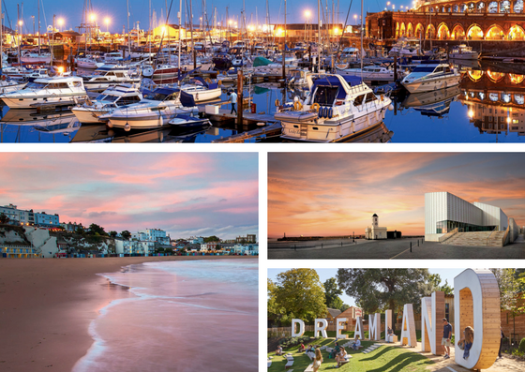
Thanet Visitor Survey - Report of Findings – Introduction
Contents:
Introduction ………………………………………………… Page 3
Executive Summary ……………………………………… Page 5
Visitor Profile………………………………………………… Page 10
Trip Characteristics ……………………………………… Page 21
Expenditure Levels ………………………………………… Page 42
Trip Influencers …..………………………………………… Page 44
Visitor Satisfaction ………………………………………. Page 50
Interpretation and Recommendations …………… Page 61
Appendix 1 – Links with Thanet's DMP………….. Page 68
Appendix 2 – 2010 vs 2018 Results ……………….. Page 71
Report prepared for Thanet District Council
Page 2

Slide 3
Thanet Visitor Survey - Report of Findings – Introduction
Thanet Visitor Survey - Report of Findings – Introduction
Introduction
Project Aim:
This project was commissioned and funded by Thanet District Council and undertaken by Visit Kent, in partnership with Destination Research Ltd. It aims to measure the changes in visitor numbers, visitor motivations and visitor profile in Thanet since the last face-to-face visitor survey in 2010. It also aims to inform the assessment of the impact of the previous DMP activities, highlighting the extent to which the Thanet DMP targets have been met. The project was divided into two research tasks.
Research stages:
Desk research and knowledge gathering stage
Face-to-face visitor surveys were undertaken by interviewers
This report presents the key findings of the Thanet Visitor Survey. The purpose of the survey was to gather information on the origin, profile and behaviour of visitors to Thanet and in particular the towns of Margate, Broadstairs and Ramsgate. The survey also sought to identify elements driving visitor satisfaction.
Survey methodology
The survey involved face-to-face interviews with a random sample of visitors encountered in key tourist locations. Those visiting for non-leisure purposes, e.g. trips concerned with their normal work, study or household shopping were not included in the survey. Residents of Thanet district were also excluded from the sample. A total of 1351 face to face interviews were conducted at specific locations within the three towns, with a split sample of 450 for each town (Margate, Broadstairs and Ramsgate). Interviews were completed in two waves. Wave 1 started in July 2018 and concluded at the end of August, covering the summer school holiday period. Overall, 669 interviews were completed across the three towns (225 in Margate, 226 in Broadstairs and 218 in Ramsgate). The second wave of interviews took place between mid-September to the end of October Half Term 2018 and the final sample was split as follows: 450 in Margate, 451 in Broadstairs and 450 in Ramsgate.
Page 3

Slide 4
Thanet Visitor Survey - Report of Findings – Introduction
Thanet Visitor Survey - Report of Findings – Introduction
Introduction
Statistical Reliability
All surveys are subject to some degree of statistical error. The size of this error will vary with the sample size, population size and the degree of cross tabulations being undertaken. The margin of error reduces as the sample increases. For the overall sample of 1351 interviews, the margin of error is + 2.7% and for each destination the margin of error is +4.6.
As satisfaction measurements rely on visitors having used or experienced a particular service or facility, interviews were conducted with visitors who were at least half way through their visit. Individual interviewing sessions were carried out from the hours of 11am to 6pm between the months of July and October 2018. Interviews were spread across weekdays and weekends to ensure that a representative sample of visitors were interviewed.
Presentation of results
Key findings are presented to the overall sample and for visitors to each interview location (Margate, Broadstairs and Ramsgate). Additional commentary and cross-tabulations are provided where there is a significant variation in results. Each subsection of the report is followed with a set of tables to complement the main results. The report also provides links to DMP deliverables. These have been presented in Appendix 1
We have also drawn some comparisons with the key results from the visitor survey carried out in 2010. These have been presented in Appendix 2.
Page 4

Slide 5
Thanet Visitor Survey - Report of Findings – Executive Summary
Thanet Visitor Survey - Report of Findings – Introduction
Executive Summary
Visitor Profile
Of the total 1351 visitors interviewed in Thanet, 93% were from the UK and 7% were from overseas. Over half of UK visitors (56%) travelled from within the South East region. Of these, 43% were from Kent. Greater London accounted for 19% of UK visitors. The main overseas markets included Germany (24%), France (14%) and the Netherlands (11%).
A higher proportion of women (55%) than men (45%) took part in the survey. There was a more marked split between male (42%) and female respondents (58%) during the summer interviews.
Couples and families accounted for almost two thirds (63%) of all visiting groups to Thanet (36% and 27% respectively). Family groups increased to 37% when intergenerational families (with grandparents) and extended families (with relatives) were included.
Ramsgate attracted the highest proportion of couples (40%). Broadstairs attracted a higher proportion of families (39%). Margate was particularly popular with groups of friends (19%) and visitors travelling alone (12%).
Couples are more likely to visit after the end of the school holiday period (42% compared to 31% in summer). Groups of friends are twice as likely to travel in the summer (24%) than during the autumn (12%). Conversely, those visiting alone are twice as likely to visit in the autumn (12%) than in the summer (6%).
Almost two thirds of respondents (63%) were in employment (employed full-time, part-time, or self-employed). Margate had the highest proportion of respondents in employment (73% in total) and lowest proportion of retired (21%). The results for Broadstairs and Ramsgate are similar and the level of visitor unemployment was very similar across the three towns.
Page 5

Slide 6
Thanet Visitor Survey - Report of Findings – Executive Summary
Thanet Visitor Survey - Report of Findings – Introduction
Executive Summary
Visitor Profile (cont.)
The largest proportions of respondents were in the intermediate (36%) and junior management (26%), followed by skilled manual workers, accounting for 21% of the total sample.
Margate attracted the lowest proportion of respondents in managerial roles compared to the other towns, with 67% of the sample. At the other end of the scale, almost three quarters (71%) of all visitors to Broadstairs were classed as ABC1. Finally, Ramsgate was placed in the middle of the three destinations with 69% of all respondents being in any of the managerial roles.
Trip Characteristics
Over half (55%) of all visitors were ‘day visitors from home’. A further 18% were also day visitors but these were visitors on day trips from holidays based elsewhere. The remaining 27% were in Thanet as part of an overnight stay.
Almost four in five (79%) day visitors spent the whole day in Thanet and 20% stayed for half a day. Summer day visitors stayed longer (83% of summer day visits lasted the whole day, compared to only 73% in autumn).
The average length of stay for overnight visitors to Thanet was 4.4 nights. Overnight visits were also longer in summer (4.8 nights per visit) than in autumn (4.1 nights per visit).
Overnight stays in Margate were the shortest (3.6 nights per trip) and overnight stays in Broadstairs were the longest (5.2 nights). Overnights visitors spent an average of 4.5 nights in Ramsgate.
Most visitors were visiting for leisure or holiday purposes (94%) and 5% were visiting friends or relatives. Leisure and holiday visits were most popular in Broadstairs (96%) and Margate (95%). Ramsgate attracted the highest proportion of visits to friends and relatives (9%).
Page 6

Slide 7
Thanet Visitor Survey - Report of Findings – Executive Summary
Thanet Visitor Survey - Report of Findings – Introduction
Executive Summary
Accommodation
Overall, a third of overnight visitors (33%) stayed in serviced accommodation and a further 29% stayed with friends and relatives. The self catering market accounted for about a quarter of all stays (23%) when traditional self catering units (14%) and Airbnb (9%) are counted together.
Touring caravans and tents are a popular choice of accommodation during the summer months. Self catering (including traditional units and Airbnb) is more popular in the autumn, accounting for 26% (compared to 20% in the summer). Similarly, serviced accommodation is more widely used in autumn. Over half (57%) of staying visitors booked their accommodation directly with the accommodation provider.
Using a rating scale of one to five, where 1 = ‘very poor’ and 5=‘very good’, satisfaction scores for accommodation providers in terms of quality of service and value for money were calculated. Accommodation establishments in Thanet achieved a score of 4.40 out of 5 for quality of service and 4.37 for value for money. Scores were higher in autumn than in the summer, both in terms of the quality of service (4.36 and 4.42 respectively) and for value for money (4.16 and 4.49 respectively).
Transport
The car (or some other private motor vehicle such as motorbike or motorhome) was the most common mode of transport used by visitors to reach Thanet, chosen by 66% of respondents. Train users accounted for 19% of all visitors to Thanet. However, train usage was significantly more popular among visitors to Margate, accounting for 30% of all trips.
Just under half of all car users (46%) had paid to use a town centre car park but usage was higher in Margate (59%) and lower in Broadstairs (34%).
Using a 5 point scale, the survey found that parking in the town centre achieved a score of 4.2 out of 5. as you would expect, parking was easier in autumn. Most respondents found the cost of parking to be ‘about average’ with a mean score of 2.7 out of 5.
Page 7

Slide 8
Thanet Visitor Survey - Report of Findings – Executive Summary
Thanet Visitor Survey - Report of Findings – Introduction
Executive Summary
Previous visits
Over three quarters (78%) of all visitors interviewed had visited the area before. Repeat visits were highest in Broadstairs where four in five (80%) had visited the town previously. Margate attracted the highest proportion of new visitors (25% of all visitors).
Visitors to Margate were equally likely to have visited (or intend to visit) Broadstairs (27%) or Ramsgate (29%). However, visitors to both Broadstairs and Ramsgate were less likely to visit Margate (21% and 18% respectively). The results of the survey also show that Ramsgate attracted the highest proportion of visitors from other destinations.
The majority of respondents to Margate (70%) had visited or planned to visit an attraction as part of their trip. Almost half (47%) had or planned to visit Turner Contemporary and a third (34%) had visited Dreamland (or intended to do so). Most visitors to Broadstairs and Ramsgate had no intention of going to a visitor attraction, accounting for 75% and 71% of all visitors respectively.
Expenditure
The average overall expenditure among staying visitors to Thanet (per person, per 24 hours) on accommodation, eating out, shopping, entertainment and travel and transport was £43.97. Accommodation and food and drink accounted for the highest proportion of the expenditure.
The average overnight visit lasted 4.4 nights, meaning that the average expenditure per person and per overnight trip was £193.46.
Day visitors from home spent an average of around £24.71 per person per day in the town, with eating out accounting for the highest proportion of expenditure.
Page 8

Slide 9
Thanet Visitor Survey - Report of Findings – Executive Summary
Thanet Visitor Survey - Report of Findings – Introduction
Executive Summary
Trip influencers
The coastline and beaches were the main influencer, selected by just over half of all respondents. They were particularly important when choosing to visit Broadstairs (59%) and least important for visits to Margate (49%).
Recreational activities (water sports, walking, cycling, etc) were particularly influential when choosing Ramsgate (34%), above the overall average of 30%. Almost a third (30%) of visitors to Margate selected attractions as a key influencer, above the average for the three towns (24%). Arts and culture also played a role in choosing Margate (18%), double the average for Thanet (9%).
Three in five visitors (62%) had not searched for destination information pre-trip – rather they relied on their previous knowledge. Of those who did search for tourism information, 12% visited the destination website (the destination website was the most widely used, selected by 14% of visitors to Broadstairs).
Similarly, almost three quarters of visitors felt it was not necessary to use any information sources during their visit. Those who did, relied primarily on printed materials (8%), printed maps (8%) and the location website/social media (7%).
Satisfaction scores
Using a scale of one to five, the ease of finding their way around the towns achieved the highest score (4.68 out of 5), followed by beach related activities, including the quality of beach experiences (4.56) and beach / coastline cleanliness (4.52).
Broadstairs achieved the highest scores for 11 out of a total of 17 indicators, including a 4.59 score for ‘General atmosphere’ and 4.67 for ‘Feeling of welcome’. Ramsgate achieved highest scores for public toilet facilities, both for availability (3.63) and cleanliness (3.29) and for ‘Traffic levels / congestion’ (4.24) and ‘Pedestrian signposting’ (4.38).
Margate achieved the highest score for ‘arts and culture’ (4.33) which is likely to be influenced by the presence of Turner Contemporary, and for indicators linked to accessibility, with a 4.34 score for both ‘Disabled accessibility’ and for ‘Prams / buggies access’.
Page 9

Slide 10
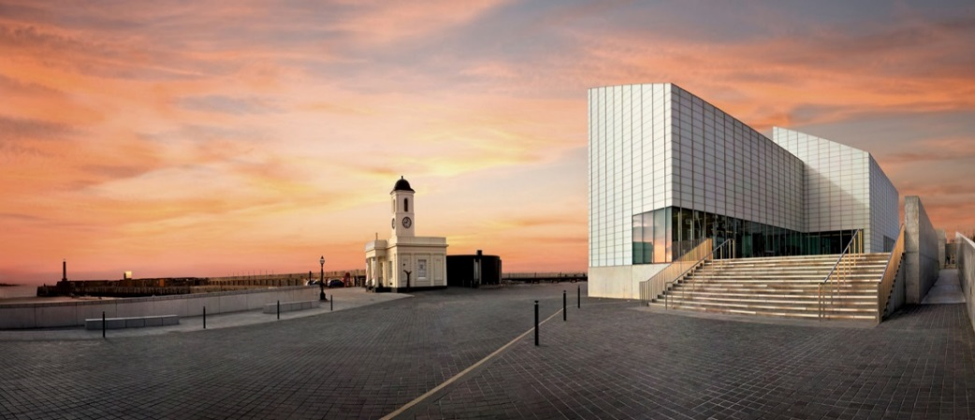
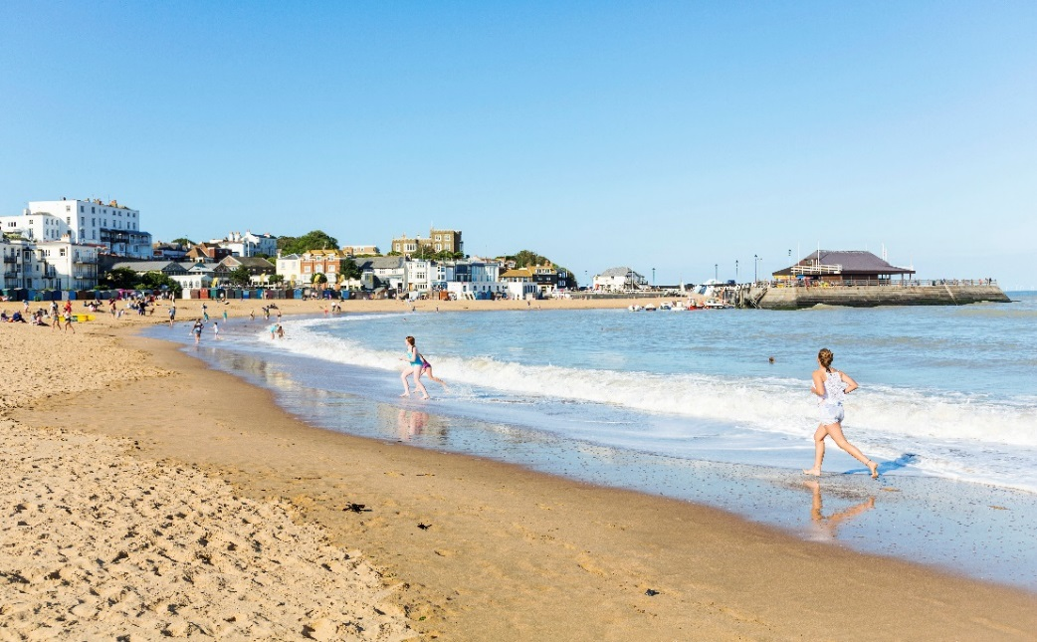
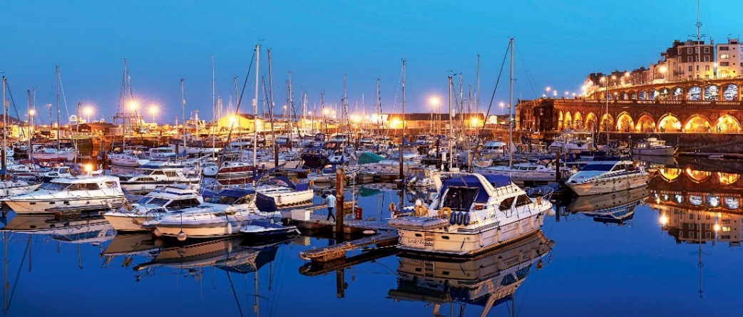
Thanet Visitor Survey - Report of Findings – Visitor Profile
Thanet Visitor Survey - Report of Findings – Visitor Profile
Survey Findings – Visitor Profile
Page 10

Slide 11
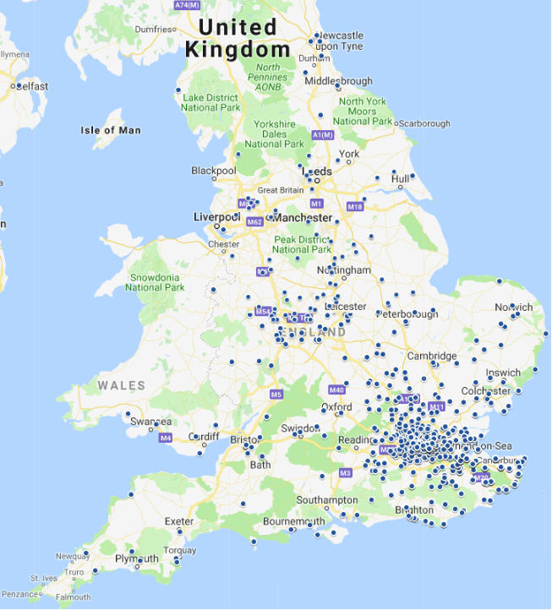
Thanet Visitor Survey - Report of Findings – Visitor Profile
Thanet Visitor Survey - Report of Findings – Introduction
Visitor Profile – Geographical breakdown
Of the total 1351 visitors interviewed on the Isle of Thanet, 93% were from the UK and 7% were from overseas. At destination level, Margate attracted the highest proportion of domestic visitors (96%). There was a similar split between domestic and overseas visitors for Broadstairs (91% domestic and 9% overseas) and Ramsgate (92% domestic and 8% overseas).
Over half of UK visitors (56%) travelled from within the South East region. Of these, 43% were from Kent, including Canterbury (5%), Rochester, Gillingham and Herne Bay (3% each). Greater London accounted for 19% of UK visitors and the East of England region for a further 13%. The main overseas markets included Germany (24%), France (14%) and the Netherlands (11%), followed by non-European countries; USA (9%), Australia (8%), New Zealand (5%) and Canada (3%). The remaining 26% of overseas visitors originated from 18 different countries.
 | UK Resident | Overseas
Thanet | 93% | 7%
Margate | 96% | 4%
Broadstairs | 91% | 9%
Ramsgate | 92% | 8%
Kent | 43%
Canterbury | 5%
Rochester | 3%
Gillingham | 3%
Herne Bay | 3%
Gravesend | 2%
Sittingbourne | 2%
Ashford | 2%
Faversham | 2%
Whitstable | 2%
Maidstone | 2%
Folkestone | 2%
Other Kent (35 locations) | 15%
Region | Postcode
South East | 56%
Greater London | 19%
East of England | 13%
East Midlands | 3%
West Midlands | 3%
South West | 2%
North West | 1%
Yorkshire and Humber | 1%
Wales | 1%
North East | 1%
Domestic visitors’ residence
Base: 1351 – prompted – Are you a UK resident or from overseas? Base: 1256 – open - What is the first part of your postcode? Base: 95 - Where do you live (Country)?
2010 Research
We noticed a higher proportion of visitor from within Kent in the 2010 sample (50%) and a slightly higher proportion from Greater London (21%)
Page 11

Slide 12
Thanet Visitor Survey - Report of Findings – Visitor Profile
Thanet Visitor Survey - Report of Findings – Introduction
Visitor Profile – Gender
The first section of this reports looks at the survey respondents and provides an overview of their profile in terms of gender, age groups, family structure and socio-economic status. It also analyses the location of their normal place of residence.
A higher proportion of women (55%) than men (45%) took part in the survey. A very similar split was achieved across the three destinations and in line with the averages for Thanet as a whole. In terms of gender split by the two main interview periods, there was a more marked split between male (42%) and female respondents (58%) during the summer interviews.
55%
45%
Base: 1351 – open – Including yourself, how many people in your immediate party are male and female, and which of these age groups do they fall into?
Page 12

Slide 13
Thanet Visitor Survey - Report of Findings – Visitor Profile
Thanet Visitor Survey - Report of Findings – Introduction
Visitor Profile
Overall, the average group size was 2.67 people, comprising of 2.26 adults and 0.41 children. More than half (55%) of Thanet’s visitors are over 45 years old.
The average visiting group is larger in the summer, with 2.90 people per average group (comprising 2.36 adults and 0.54 children). Children under 15 account for 19% of all visitors. Visitors aged under 45 years old make up just over half (51%) of the total sample.
Conversely, visiting groups in the autumn are smaller and older. The average group size is 2.44 people (2.17 adults and 0.27 children). Visitors aged under 45 years old make up only 38% of the total sample. Those aged over 45 years of age account for 62% of all autumn visitors (compared to 49% in the summer months).
2010 Research
Over 45s accounted for 42% in the 2010 sample compared to 55% in 2018.
Total sample
2.67 people
2.26 adults
0.41 children
Summer
2.90 people
2.36 adults
0.54 children
Autumn
2.44 people
2.17 adults
0.27 children
Secondary Research
Base: 1351 – open – Including yourself, how many people in your immediate party are male and female, and which of these age groups do they fall into?
Despite general changes in the consumer landscape, as markets become ageing societies – Visit England (1), Thanet holds appeal to both the younger and older demographic in terms of visitor needs - Visit Kent (30). – See Secondary Research Report, Page 4 and 19.
Page 13

Slide 14
Thanet Visitor Survey - Report of Findings – Visitor Profile
Thanet Visitor Survey - Report of Findings – Introduction
Visitor Profile
Looking at destination level, Margate attracted the youngest visitors, with over half (53%) being under 45 years of age and a quarter (25%) under 24 years old. The average group size was 2.65 people, comprising of 2.25 adults and 0.40 children. Broadstairs had the highest proportion of children under 15 (18%) although the under 45s accounted for under half (45%) of all visitors The average group size for Broadstairs was 2.71 people, comprising of 2.23 adults and 0.48 children. Finally, Ramsgate attracted the older age groups, with 62% being over 45 years old. Ramsgate also attracted a proportionally lower number of children (13%) and young adults – the 16-24 age group accounted for only 5% of the total visitors to the destination. The average group size was 2.65 people, comprising of 2.31 adults and 0.34 children.
Secondary Research
Base: 1351 – open – Including yourself, how many people in your immediate party are male and female, and which of these age groups do they fall into?
Details about the different needs of younger and older visitors (45+) at destination level are described in Visit Kent (2018) A bespoke approach to the Kent coastal tourism economy – See Secondary Research Report, Page 19.
Page 14

Slide 15
Thanet Visitor Survey - Report of Findings – Visitor Profile
Thanet Visitor Survey - Report of Findings – Introduction
Visitor Profile – Party composition
Couples and families accounted for almost two thirds (63%) of all visiting groups to Thanet (36% and 27% respectively). Family groups increased to 37% when intergenerational families (with grandparents) and extended families (with relatives) were included. Of the three individual destinations, Ramsgate attracted the highest proportion of couples (40%). When compared to the district average, Broadstairs attracted a higher proportion of family units (31%) and all family groups (including integrational and extended families), accounting for 39% of all visiting groups. The proportion of groups of friends visiting Margate was marginally higher (19%) than the average for the three towns (18%). Margate was also popular with visitors travelling alone, accounting for 12% of all visitors to the town.
A comparison between summer and autumn waves highlights some interesting differences. Couples are more likely to visit after the end of the school holiday period, accounting for more than two in five visiting groups (42%) during that period, compared to 31% during the summer months. The proportion of groups of friends visiting in the summer (24%) is twice as large than during the autumn (12% of all autumn visiting groups). Conversely, those visiting alone are twice as likely to visit in autumn (12%) than during the summer (6%)
Group composition | Thanet | Margate | Broadstairs | Ramsgate
A couple | 36% | 33% | 36% | 40%
Family unit | 27% | 27% | 31% | 22%
Groups of friends | 18% | 19% | 18% | 16%
Alone | 9% | 12% | 7% | 9%
Intergenerational family (with grandparents) | 5% | 5% | 4% | 7%
Extended family (with relatives) | 5% | 4% | 4% | 6%
Specialist/interest group | 0% | 0% | 1% | 0%
Other | 0% | 0% | 0% | 0%
Base: 1351 – prompted – How would you describe your visiting party?
Page 15

Slide 16
Thanet Visitor Survey - Report of Findings – Visitor Profile
Thanet Visitor Survey - Report of Findings – Introduction
Visitor Profile – Employment and socio-economic status
Almost two thirds of respondents (63%) were in employment, either employed full-time (51%), part-time (6%) or self-employed (7%). Just under a third of respondents were retired from employment (31%). We notice some differences when comparing these results at destination level. This is particularly significant with Margate, which had the highest proportion of respondents in employment (73% in total) and lowest proportion of retired (21%). It also accounted for most of the students interviewed across the district. The employment status of visitors to Broadstairs and Ramsgate are similar. However, compared to the district averages, we noticed a lower proportion of respondents in employment (61% in Broadstairs and 59% in Ramsgate) and a higher proportion of retired respondents (35% and 37%, respectively). The level of unemployment was very similar across the three towns.
When comparing seasonal differences, the proportion of respondents in employment (employed full-time, part-time or self-employed) was highest in the summer months (66%) compared to 62% in autumn. Conversely, those retired accounted for 27% of all summer respondents, but they represented more than a third (35%) of the autumn sample. The majority of unemployed visitors was recorded in the summer months. Students were spread across the whole of the interview period.
 | Thanet | Margate | Broadstairs | Ramsgate
Employed full-time (30+ hrs / week) | 51% | 56% | 50% | 47%
Employed part-time (up to 29 hrs / week) | 6% | 9% | 4% | 6%
Self-employed | 7% | 8% | 7% | 6%
Retired | 31% | 21% | 35% | 37%
Full-time student living at home | 1% | 2% | 1% | 0%
Full -time student living away | 1% | 2% | 0% | 0%
Unemployed | 3% | 3% | 2% | 3%
Base: 1351 – prompted – Which of the following categories applies to the chief income earner in the household?
Page 16

Slide 17
Thanet Visitor Survey - Report of Findings – Visitor Profile
Thanet Visitor Survey - Report of Findings – Introduction
Visitor Profile – Employment and socio-economic status
The largest proportions of respondents were in the intermediate (36%) and junior management (26%), followed by skilled manual workers, accounting for 21% of the total sample. The occupation of the household’s main income earners reflects the national splits for socio-economic grades.
Looking at the combined percentage of respondents in the ABC1 groups, which include all the managerial roles (high, intermediate and junior managerial jobs), Margate attracted the lowest proportion of respondents in managerial roles compared to the other towns, with 67% of the sample. At the other end of the scale, almost three quarters (71%) of all visitors to Broadstairs were classed as ABC1. Finally, Ramsgate was placed in the middle of the three destinations with 69% of all respondents being in a managerial role.
There were also some clear seasonal differences. The proportion of ABC1 groups in summer was significantly lower (63%) than in the autumn (74%).
 | Thanet | Margate | Broadstairs | Ramsgate | Summer | Autumn
High managerial, administrative or professional | 7% | 7% | 9% | 6% | 4% | 10%
Intermediate managerial, administrative or professional | 36% | 32% | 38% | 37% | 34% | 37%
Supervisor; clerical; junior managerial, administrative or professional | 26% | 28% | 24% | 26% | 25% | 27%
Skilled manual worker | 21% | 20% | 20% | 23% | 25% | 18%
Semi-skilled or unskilled manual worker | 6% | 7% | 6% | 6% | 8% | 5%
Housewife/homemaker | 1% | 1% | 1% | 1% | 3% | 1%
Unemployed | 1% | 2% | 1% | 1% | 1% | 1%
Student | 1% | 3% | 1% | 0% | 1% | 1%
Base: 1351 – prompted – What is the occupation of the household’s chief income earner?
Page 17

Slide 18
Thanet Visitor Survey - Report of Findings – Visitor Profile
Thanet Visitor Survey - Report of Findings – Visitor Profile
Additional Tables - Visitor Profile - Age groups and gender
 | Thanet | Margate | Broadstairs | Ramsgate
0-15 | 15% | 15% | 18% | 13%
16-24 | 7% | 10% | 6% | 5%
25-34 | 11% | 14% | 9% | 11%
35-44 | 12% | 14% | 12% | 9%
45-54 | 15% | 16% | 13% | 16%
55-64 | 16% | 14% | 17% | 18%
65+ | 24% | 17% | 25% | 28%
 | Thanet | Summer | Autumn
0-15 | 15% | 19% | 11%
16-24 | 7% | 9% | 5%
25-34 | 11% | 12% | 10%
35-44 | 12% | 11% | 12%
45-54 | 15% | 15% | 15%
55-64 | 16% | 15% | 18%
65+ | 24% | 19% | 29%
 | Thanet | Margate | Broadstairs | Ramsgate
Children | 0.41 | 0.40 | 0.48 | 0.34
Adults | 2.26 | 2.25 | 2.23 | 2.31
Total Group | 2.67 | 2.65 | 2.71 | 2.66
 | Thanet | Summer | Autumn
Children | 0.41 | 0.54 | 0.27
Adults | 2.26 | 2.36 | 2.17
Total Group | 2.67 | 2.90 | 2.44
 | Thanet | Margate | Broadstairs | Ramsgate
Total males | 45% | 45% | 44% | 45%
Total females | 55% | 55% | 56% | 55%
 | Thanet | Summer | Autumn
Total males | 45% | 42% | 48%
Total females | 55% | 58% | 52%
Page 18

Slide 19
Thanet Visitor Survey - Report of Findings – Visitor Profile
Thanet Visitor Survey - Report of Findings – Visitor Profile
Tables - Visitor Profile - Employment and group composition
Group composition | Thanet | Margate | Broadstairs | Ramsgate
A couple | 36% | 33% | 36% | 40%
Family unit | 27% | 27% | 31% | 22%
Groups of friends | 18% | 19% | 18% | 16%
Alone | 9% | 12% | 7% | 9%
Intergenerational family (with grandparents) | 5% | 5% | 4% | 7%
Extended family (with relatives) | 5% | 4% | 4% | 6%
Specialist/interest group | 0% | 0% | 1% | 0%
Other | 0% | 0% | 0% | 0%
Employment | Thanet | Margate | Broadstairs | Ramsgate
Employed full-time (30+ hrs per week) | 51% | 56% | 50% | 47%
Employed part-time (up to 29 hrs per week) | 6% | 9% | 4% | 6%
Self-employed | 7% | 8% | 7% | 6%
Retired | 31% | 21% | 35% | 37%
Full-time student living at home | 1% | 2% | 1% | 0%
Full -time student living away | 1% | 2% | 0% | 0%
Unemployed | 3% | 3% | 2% | 3%
Group composition | Full sample | Summer | Autumn
A couple | 36% | 31% | 42%
Family unit | 27% | 28% | 26%
Groups of friends | 18% | 24% | 12%
Alone | 9% | 6% | 12%
Intergenerational family (with grandparents) | 5% | 6% | 5%
Extended family (with relatives) | 5% | 6% | 4%
Specialist/interest group | 0% | 0% | 0%
Other | 0% | 0% | 0%
Employment | Full sample | Summer | Autumn
Employed full-time (30+ hrs per week) | 51% | 56% | 45%
Employed part-time (up to 29 hrs per week) | 6% | 6% | 7%
Self-employed | 7% | 4% | 10%
Retired | 31% | 27% | 35%
Full-time student living at home | 1% | 1% | 1%
Full -time student living away | 1% | 1% | 1%
Unemployed | 3% | 5% | 1%
Page 19

Slide 20
Thanet Visitor Survey - Report of Findings – Visitor Profile
Thanet Visitor Survey - Report of Findings – Visitor Profile
Tables - Visitor Profile - Employment and group composition
 | Thanet | Margate | Broadstairs | Ramsgate | Summer | Autumn
High managerial, administrative or professional | 7% | 7% | 9% | 6% | 4% | 10%
Intermediate managerial, administrative or professional | 36% | 32% | 38% | 37% | 34% | 37%
Supervisor; clerical; junior managerial, administrative or professional | 26% | 28% | 24% | 26% | 25% | 27%
Skilled manual worker | 21% | 20% | 20% | 23% | 25% | 18%
Semi-skilled or unskilled manual worker | 6% | 7% | 6% | 6% | 8% | 5%
Housewife/homemaker | 1% | 1% | 1% | 1% | 3% | 1%
Unemployed | 1% | 2% | 1% | 1% | 1% | 1%
Student | 1% | 3% | 1% | 0% | 1% | 1%
Page 20

Slide 21
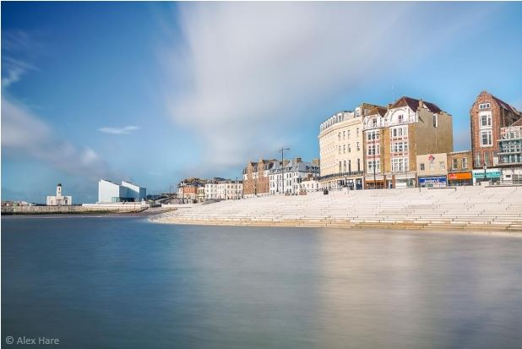
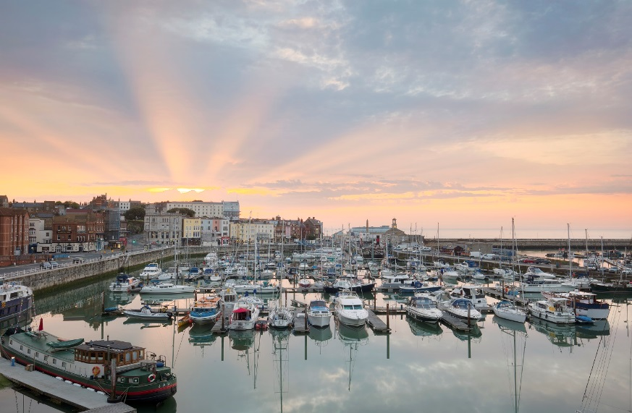
Thanet Visitor Survey - Report of Findings – Trip Characteristics
Thanet Visitor Survey - Report of Findings – Trip Characteristics
Survey Findings – Trip Characteristics
Credit: Thanet District Council
Page 21

Slide 22
Thanet Visitor Survey - Report of Findings – Trip Characteristics
Thanet Visitor Survey - Report of Findings – Introduction
Type of trip
Over half (55%) of all visitors were ‘day visitors from home’ – visitors who started their trip that day from their home residence and planned to return to their residence on the same day. A further 18% were also day visitors but these were visitors on day trips from holidays based elsewhere. The remaining 27% were in Thanet as part of an overnight stay.
The results of the survey show that the distribution of visitors across the three main types was very similar in Broadstairs and Ramsgate. Margate had a higher proportion of staying visitors (30%) of all visitors to the town.
2010 Research
We noticed a slight increase in the proportion of day visitors from home between 2010 (50%) and 2018 (55%).
 | Thanet | Margate | Broadstairs | Ramsgate
Day visitors from home | 55% | 55% | 55% | 54%
Day visitors (touring) | 18% | 15% | 19% | 20%
Staying visitors | 27% | 30% | 26% | 26%
Secondary Research
Base: 1351 – prompted – Are you staying overnight during your trip? Base 614 – prompted - Are you staying overnight in Location? - (interviewer to code)
The higher proportion of day trips matches the findings from the Visit Kent Perceptions Research (17), which suggests that the interest in day trip visitation is much stronger than overnight or short stays – See Secondary Research Report, Page 17.
Page 22

Slide 23
Thanet Visitor Survey - Report of Findings – Trip Characteristics
Thanet Visitor Survey - Report of Findings – Introduction
Duration of the trip
Almost four in five (79%) day visitors spent the whole day in Thanet and 20% stayed for half a day. A marginal 1% of day visitors made short visits (less than two hours). In terms of seasonality, summer day visits were longer (83% of summer day visits lasted the whole day, compared to only 73% in autumn). Day visitors to Broadstairs stayed the longest on average (81% stayed all day in the town), whereas Ramsgate attracted the shorter day visits, with three quarters of visitors (75%) spending the full day at the destination and 23% spending half a day.
The average length stay for overnight visitors to Thanet was 4.4 nights. Overnight visits were also longer in summer (4.8 nights per visit) than in autumn (4.1 nights per visit). Overnight stays in Margate were the shortest (3.6 nights per trip) and overnight stays in Broadstairs were the longest (5.2 nights). Overnight visitors spent an average of 4.5 nights in Ramsgate.
Day visit length
Overnight average length of stay
 | Thanet | Margate | Broadstairs | Ramsgate
Less than 2 hours | 2% | 1% | 2% | 2%
Half a day | 20% | 20% | 16% | 23%
All day | 79% | 79% | 81% | 76%
Nights per trip | All responses | Summer | Autumn
Thanet | 4.4 | 4.8 | 4.1
Margate | 3.6 | 3.8 | 3.4
Broadstairs | 5.2 | 5.2 | 5.3
Ramsgate | 4.5 | 5.4 | 3.7
Base: 737 – prompted – How long are you planning to spend here today? Base: 614 – open – How many nights are you spending away from home?
Page 23

Slide 24
Thanet Visitor Survey - Report of Findings – Trip Characteristics
Thanet Visitor Survey - Report of Findings – Introduction
Touring trips
Touring visitors (on a day visit but staying overnight elsewhere as part of their holiday) were asked to indicate the location of their holiday accommodation. Most were staying elsewhere within Thanet or somewhere else in Kent (popular destinations included Whitstable, Herne Bay and Canterbury). The results show that 47% of touring visitors interviewed in Margate were visiting other locations within Thanet district. For those interviewed in Ramsgate the proportion that were touring the district was 52% and Broadstairs had the highest proportion (60%) of touring visitors that visited other locations within the district.
When asked about the reason for staying elsewhere, about two thirds said they were holidaying elsewhere. Some gave ‘other reasons’, primarily that they were staying with friends or relatives based elsewhere in and around Kent.
Ramsgate
Margate
Broadstairs (30%)
Margate (17%)
Whitstable (9%)
Deal (6%)
Canterbury (5%)
Birchington (3%),
Dover (3%)
Herne Bay (2%)
London (2%)
Lyminge (2%)
Walmer (2%)
Westgate (2%)
12 other locations (12%)
Broadstairs (22%)
Whitstable (13%)
Herne Bay (12%)
Ramsgate (12%)
Canterbury (9%)
Birchington (6%)
Deal (6%)
Westgate (4%)
Minster (3%)
10 other locations (14%)
Broadstairs
Ramsgate (24%)
Margate (19%)
Whitstable (11%)
Canterbury (9%)
Birchington (8%)
Westgate (5%)
Minster (4%)
Herne Bay (4%)
12 other locations (18%)
Base 247 – Open – Where are you staying? Base: 247 – prompted – Is there any particular reason why you didn’t stay in Location (interviewer to code)?
Page 24

Slide 25
Thanet Visitor Survey - Report of Findings – Trip Characteristics
Thanet Visitor Survey - Report of Findings – Introduction
Leisure and holiday trips
Reason for visiting
Margate
95%
Most visitors were visiting for leisure or holiday purposes (94%). A minority of visitors (representing 5% of all visits) were visiting Thanet to see friends or relatives. One percent of visitors were on a study related trip, including foreign students.
Leisure and holiday visits were most popular in Broadstairs (96%) and Margate (95%). Ramsgate attracted the highest proportion of visits to friends and relatives, accounting for 9% of all visits to the town.
Broadstairs
96%
Leisure and holiday trips as proportion of all trips
Total sample Summer Autumn
 | Margate | Broadstairs | Ramsgate
Leisure/Holiday | 95% | 96% | 91%
Visiting friends/relatives | 4% | 3% | 9%
Study (Incl. foreign student) | 1% | 1% | 0%
94%
97%
91%
Ramsgate
91%
 | All visits | Summer | Autumn
Leisure/Holiday | 94% | 97% | 91%
Visiting friends/relatives | 5% | 3% | 7%
Study (Incl. foreign student) | 1% | 0% | 1%
2010 Research
Larger proportion of people in VFR. Probably linked to leisure trips up in 2018, many using paid accommodation.
Base: 1351 – prompted – What is your main reason for visiting?
Page 25

Slide 26
Thanet Visitor Survey - Report of Findings – Trip Characteristics
Thanet Visitor Survey - Report of Findings – Visitor Profile
Additional Tables – Trip Characteristics – Reason for visiting and type of trip
Full sample | Thanet | Margate | Broadstairs | Ramsgate
Leisure/Holiday | 94% | 95% | 96% | 91%
Study (Incl. foreign student) | 1% | 1% | 1% | 0%
(Non-regular) Shopping trip | 0% | 0% | 0% | 0%
Visiting friends/relatives | 5% | 4% | 3% | 9%
Summer | Thanet | Margate | Broadstairs | Ramsgate
Leisure/Holiday | 97% | 98% | 97% | 94%
Study (Incl. foreign student) | 0% | 0% | 0% | 0%
(Non-regular) Shopping trip | 0% | 0% | 0% | 0%
Visiting friends/relatives | 3% | 2% | 2% | 6%
Autumn | Thanet | Margate | Broadstairs | Ramsgate
Leisure/Holiday | 91% | 92% | 95% | 88%
Study (Incl. foreign student) | 1% | 1% | 3% | 0%
(Non-regular) Shopping trip | 0% | 1% | 0% | 0%
Visiting friends/relatives | 7% | 6% | 3% | 12%
 | Thanet | Margate | Broadstairs | Ramsgate
Day visitors from home | 55% | 55% | 55% | 54%
Day visitors (touring) | 18% | 15% | 19% | 20%
Staying visitors | 27% | 30% | 26% | 26%
 | All visits | Summer | Autumn
Day visitors from home | 55% | 61% | 49%
Day visitors (touring) | 18% | 15% | 22%
Staying visitors | 27% | 24% | 30%
Page 26

Slide 27
Thanet Visitor Survey - Report of Findings – Trip Characteristics
Thanet Visitor Survey - Report of Findings – Introduction
Overnight visitors – Accommodation
Overall, a third of the overnight visitors (33%) stayed in serviced accommodation (hotels - 26% and B&B/ guest houses - 7%) and a further 29% stayed with friends and relatives. The self catering market is also very important, accounting for about a quarter (23%) of all stays when traditional self catering units (14%) and Airbnb (9%) are counted together. The results also show some significant differences in the use of accommodation depending on the time of the year and the destination.
As you would expect, touring caravans and tents are a popular choice of accommodation during the summer months, as they are the most whether dependant type of accommodation. Self catering (including traditional units and Airbnb) is more popular in the autumn, accounting for 26% (compared to 20% in the summer). Similarly, serviced accommodation is more widely used in autumn. Within this sector, hotels are proportionately used more often in autumn (30%) than in summer (22%), whereas B&Bs and guest houses are more likely to be used in the summer months (9% compared to 6% in autumn).
 | Thanet | Margate | Broadstairs | Ramsgate
Hotel | 26% | 29% | 25% | 25%
Bed and Breakfast/Guest house | 7% | 10% | 8% | 5%
Rented Self-catering accommodation | 14% | 10% | 18% | 14%
Touring caravan / Camping | 6% | 5% | 7% | 7%
Friends and Relatives | 29% | 27% | 25% | 34%
Airbnb | 9% | 16% | 7% | 4%
Other | 8% | 3% | 11% | 10%
Secondary Research
The high satisfaction scores supports Visit Kent’s Perception research showing quality of accommodation in the district standing above the GB average.
Base: 614 – prompted – What type of accommodation are you staying in?
Page 27

Slide 28
Thanet Visitor Survey - Report of Findings – Trip Characteristics
Thanet Visitor Survey - Report of Findings – Introduction
Overnight visitors – Accommodation
Respondents were asked to rate their accommodation establishment in terms of the quality of service and value for money, using a five point scale – Very Good (5 points), Good, Average, Poor and Very Poor (1 point).
Overall, the scores were high. Accommodation establishments in Thanet achieved a score of 4.40 out of 5 for quality of service and 4.37 for value for money. Interestingly, scores were higher in the autumn than in the summer, both in terms of the quality of service (4.36 and 4.42 respectively) and the value for money (4.16 and 4.49 respectively).
Looking at the three towns, Margate achieved the highest scores for both, quality of service (4.51 out of 5) and value for money (4.44 out of 5). Interestingly, the scores for Margate’s accommodation were significantly better in the autumn than in the summer.
Conversely, Broadstairs achieved better scores during the summer months, both in terms of the quality of service (4.61) and the value for money (4.51), compared to the autumn scores of 4.27 for the quality of service and 4.29 for the value for money.
Ramsgate achieved the lowest scores across the board. However, we should be cautious when comparing scores at destination level. We ought to take into account some of the differences in the profile of the visitors to each of the destinations (as described in the previous section of this report) as their perceptions and expectations might be different. Also, the difference in the accommodation available can be a contributing factor.
Quality of service | All visits | Summer | Autumn
Thanet | 4.40 | 4.36 | 4.42
Margate | 4.51 | 4.34 | 4.57
Broadstairs | 4.47 | 4.61 | 4.27
Ramsgate | 4.27 | 4.13 | 4.33
Value for money | All visits | Summer | Autumn
Thanet | 4.37 | 4.16 | 4.49
Margate | 4.44 | 4.09 | 4.64
Broadstairs | 4.42 | 4.51 | 4.29
Ramsgate | 4.26 | 3.85 | 4.47
Secondary Research
Base: 614 – prompted – How would you rate the quality of service provided by your accommodation establishment? Base: 614 – prompted – How would you rate your accommodation in terms of value for money?
These high satisfaction scores would support the findings from Visit Kent’s Perception Research - Isle of Thanet (18), which shows that the quality of accommodation in the district ranked above the GB average. – See Secondary Research Report, Page 18.
Page 28

Slide 29
Thanet Visitor Survey - Report of Findings – Trip Characteristics
Thanet Visitor Survey - Report of Findings – Introduction
Overnight visitors – Accommodation – Accommodation booking
Over half (57%) of staying visitors booked their accommodation directly with the accommodation provider. In terms of online travel agents (OTAs), Booking.com, with 18% of all bookings, was the most widely used across the three towns. Airbnb accounted for 13% of all bookings across Thanet and was particular popular with visitors staying in Margate, accounting for 19% of all accommodation bookings.
 | Thanet | Margate | Broadstairs | Ramsgate
TripAdvisor | 4% | 4% | 4% | 4%
Booking.com | 18% | 19% | 20% | 16%
Expedia | 1% | 1% | 2% | 0%
Trivago | 1% | 0% | 1% | 1%
Direct with provider | 57% | 51% | 57% | 63%
AirBnB | 13% | 19% | 9% | 11%
other | 6% | 6% | 7% | 5%
Secondary Research
The high percentage of direct bookings with accommodation providers could be linked with emerging trends such as the personalisation of content (filter bubble trend) – See Secondary Research Report, Page 4.
Base: 367 – prompted – How did you book your accommodation?
Page 29

Slide 30
Thanet Visitor Survey - Report of Findings – Trip Characteristics
Thanet Visitor Survey - Report of Findings – Visitor Profile
Additional Tables – Overnight visitors – Destination of choice and Accommodation
Accommodation used | All responses | Summer | Autumn
Base | 614 | 264 | 350
Hotel | 26% | 30% | 22%
Bed and Breakfast/Guest house | 7% | 6% | 9%
Rented Self-catering accommodation | 14% | 16% | 12%
Touring caravan / Camping | 6% | 3% | 11%
Friends and Relatives | 29% | 28% | 29%
Airbnb | 9% | 10% | 8%
Other | 8% | 8% | 9%
Staying overnight at the destination? | All responses | Summer | Autumn
Base | 614 | 264 | 350
Ramsgate | 56% | 54% | 58%
Broadstairs | 57% | 60% | 56%
Margate | 66% | 74% | 61%
Reason for not stay at destination? | Margate | Broadstairs | Ramsgate
Base | 69 | 87 | 91
Holidaying elsewhere | 70% | 64% | 65%
Poor range of accommodation in Destination | 0% | 0% | 1%
Destination is not an appealing place to stay | 1% | 0% | 0%
No availability in Destination | 4% | 7% | 1%
Too expensive /cheaper elsewhere | 1% | 3% | 0%
Other | 23% | 25% | 33%
 | Thanet | Margate | Broadstairs | Ramsgate
Hotel | 26% | 29% | 25% | 25%
Bed and Breakfast/Guest house | 7% | 10% | 8% | 5%
Rented Self-catering accommodation | 14% | 10% | 18% | 14%
Touring caravan / Camping | 6% | 5% | 7% | 7%
Friends and Relatives | 29% | 27% | 25% | 34%
Airbnb | 9% | 16% | 7% | 4%
Other | 8% | 3% | 11% | 10%
Page 30

Slide 31
Thanet Visitor Survey - Report of Findings – Trip Characteristics
Thanet Visitor Survey - Report of Findings – Visitor Profile
Additional Tables – Overnight visitors - Accommodation
Quality of service provided (all responses) Summer interviews Autumn interviews
 | Thanet | Margate | Broadstairs | Ramsgate
Base | 614 | 203 | 204 | 207
Very good | 51% | 58% | 53% | 40%
Good | 40% | 35% | 41% | 48%
Average | 8% | 7% | 6% | 10%
Poor | 1% | 0% | 0% | 1%
Very Poor | 0% | 0% | 0% | 0%
 | Thanet | Margate | Broadstairs | Ramsgate
Base | 201 | 66 | 74 | 58
Very good | 54% | 51% | 72% | 35%
Good | 33% | 37% | 20% | 47%
Average | 9% | 10% | 7% | 13%
Poor | 3% | 1% | 0% | 5%
Very Poor | 1% | 1% | 1% | 0%
 | Thanet | Margate | Broadstairs | Ramsgate
Base | 277 | 106 | 90 | 83
Very good | 48% | 62% | 36% | 42%
Good | 46% | 34% | 56% | 48%
Average | 6% | 4% | 6% | 10%
Poor | 0% | 0% | 1% | 0%
Very Poor | 0% | 0% | 0% | 0%
Value for money (all responses) Summer interviews Autumn interviews
 | Thanet | Margate | Broadstairs | Ramsgate
Base | 614 | 203 | 204 | 207
Very good | 51% | 58% | 50% | 44%
Good | 36% | 29% | 42% | 39%
Average | 12% | 12% | 8% | 15%
Poor | 1% | 1% | 0% | 2%
Very Poor | 0% | 0% | 0% | 0%
 | Thanet | Margate | Broadstairs | Ramsgate
Base | 201 | 66 | 74 | 58
Very good | 45% | 42% | 64% | 24%
Good | 32% | 29% | 25% | 46%
Average | 19% | 24% | 10% | 24%
Poor | 3% | 3% | 0% | 5%
Very Poor | 1% | 1% | 1% | 2%
 | Thanet | Margate | Broadstairs | Ramsgate
Base | 277 | 106 | 90 | 83
Very good | 55% | 68% | 37% | 56%
Good | 38% | 27% | 56% | 34%
Average | 6% | 5% | 5% | 10%
Poor | 0% | 0% | 1% | 0%
Very Poor | 0% | 0% | 0% | 0%
Page 31

Slide 32
Thanet Visitor Survey - Report of Findings – Trip Characteristics
Thanet Visitor Survey - Report of Findings – Visitor Profile
Additional Tables – Overnight visitors - Accommodation
Booking accommodation
Satisfaction with service provided and value for money
 | Thanet | Margate | Broadstairs | Ramsgate
Base | 367 | 129 | 128 | 110
TripAdvisor | 4% | 4% | 4% | 4%
Booking.com | 18% | 19% | 20% | 16%
Expedia | 1% | 1% | 2% | 0%
Trivago | 1% | 0% | 1% | 1%
Direct with provider | 57% | 51% | 57% | 63%
AirBnB | 13% | 19% | 9% | 11%
other | 6% | 6% | 7% | 5%
Service provided | All visits | Summer | Autumn
Thanet | 4.40 | 4.36 | 4.42
Margate | 4.51 | 4.34 | 4.57
Broadstairs | 4.47 | 4.61 | 4.27
Ramsgate | 4.27 | 4.13 | 4.33
Value for money | All visits | Summer | Autumn
Thanet | 4.37 | 4.16 | 4.49
Margate | 4.44 | 4.09 | 4.64
Broadstairs | 4.42 | 4.51 | 4.29
Ramsgate | 4.26 | 3.85 | 4.47
 | All visits | Summer | Autumn
Base | 367 | 154 | 213
TripAdvisor | 4% | 0% | 7%
Booking.com | 18% | 19% | 18%
Expedia | 1% | 1% | 1%
Trivago | 1% | 1% | 0%
Direct with accommodation provider | 52% | 55% | 50%
AirBnB | 13% | 15% | 12%
other | 11% | 9% | 12%
Page 32

Slide 33
Thanet Visitor Survey - Report of Findings – Trip Characteristics
Thanet Visitor Survey - Report of Findings – Visitor Profile
Additional Tables – Overnight visitors - Accommodation
Booking accommodation - Seasonality
Summer | Thanet | Margate | Broadstairs | Ramsgate
Base | 154 | 49 | 55 | 50
TripAdvisor | 0% | 0% | 0% | 0%
Booking.com | 19% | 16% | 25% | 14%
Expedia | 1% | 2% | 2% | 0%
Trivago | 1% | 0% | 2% | 0%
Direct with accommodation provider | 56% | 47% | 56% | 64%
AirBnB | 15% | 27% | 5% | 14%
Other | 8% | 8% | 9% | 8%
Summer interviews
Autumn | Thanet | Margate | Broadstairs | Ramsgate
Base | 213 | 80 | 73 | 60
TripAdvisor | 7% | 6% | 7% | 7%
Booking.com | 18% | 20% | 15% | 18%
Expedia | 1% | 0% | 3% | 0%
Trivago | 0% | 0% | 0% | 2%
Direct with accommodation provider | 57% | 54% | 58% | 62%
AirBnB | 12% | 15% | 12% | 8%
Other | 5% | 5% | 5% | 3%
Autumn interviews
Page 33

Slide 34
Thanet Visitor Survey - Report of Findings – Trip Characteristics
Thanet Visitor Survey - Report of Findings – Introduction
Transport
The car (or some other private motor vehicle such as a motorbike or motorhome) was the most common mode of transport used by visitors to reach Thanet, chosen by 66% of respondents. Train users accounted for 19% of all visitors to Thanet. However, train usage was significantly more popular among visitors to Margate, accounting for 30% of all trips. Coach trips were more frequent in Margate and Broadstairs (6% each) compared to only 3% of all trips to Ramsgate.
2010 Research
Significant increase in the number of visitors travelling to Margate by train since 2010 (11% up to 30%).
 | Margate | Broadstairs | Ramsgate
Car / van/motorhome | 54% | 71% | 72%
Train | 30% | 16% | 12%
Coach | 6% | 6% | 3%
Bus | 4% | 3% | 3%
Ferry | 0% | 0% | 0%
Boat (Yacht, etc.) | 0% | 0% | 2%
Bike | 1% | 0% | 1%
Other | 5% | 4% | 6%
Secondary Research
Base: 1351 – prompted – What was the main form of transport you used to reach the destination? Base: 893 – prompted – Have you paid to use any of the town centre car parks today?
Transport links and ease of getting to and around are seen as one of the key motivators for visiting the Isle of Thanet according to the perception research conducted by Visit Kent (2017) and NCTA (2017). – See Secondary Research Report, Pages 16 and 21.
Page 34

Slide 35
Thanet Visitor Survey - Report of Findings – Trip Characteristics
Thanet Visitor Survey - Report of Findings – Introduction
Transport - Use of car parks
Just under half of all car users (46%) paid to use a town centre car park but usage was higher in Margate (59%) and lower in Broadstairs (34%). Respondents were asked to rate parking in the town centre and the cost of parking using a five point scale – very easy / very reasonable (5 points) to very difficult / very expensive (1 point). The survey found that parking in the town centre achieved a score of 4.2 out of 5. As you would expect, parking was easier in autumn. Most respondents found the cost of parking to be ‘about average’ with an mean score of 2.7 out of 5. Scores differed slightly at destination level. Margate achieved the highest scores for both ease of parking (4.4) and cost (3.1) and Broadstairs achieved the lowest (3.9 and 2.3 respectively).
 | Thanet | Margate | Broadstairs | Ramsgate
Yes, in a car park | 30% | 40% | 21% | 30%
Yes, using pay and display | 16% | 19% | 13% | 18%
No | 54% | 41% | 66% | 52%
2.8
2.6
Satisfaction with:
4.0
Base: 893 – prompted – Have you paid to use any of the town centre car parks today? Base: 413 – prompted - How easy did you find it to park in the town centre? Base: 413 – prompted - How would you rate the cost of parking in Location (interviewer to code)?
Page 35

Slide 36
Thanet Visitor Survey - Report of Findings – Trip Characteristics
Thanet Visitor Survey - Report of Findings – Visitor Profile
Additional Tables – Transport
Use of town centre carparks | Thanet | Margate | Broadstairs | Ramsgate
Base | 893 | 245 | 322 | 326
Yes, in a car park | 30% | 40% | 21% | 30%
Yes, using pay and display | 17% | 19% | 13% | 18%
No | 54% | 41% | 66% | 52%
Transport used | Thanet | Margate | Broadstairs | Ramsgate
Base | 1351 | 450 | 451 | 450
Car / van/motorhome | 66% | 54% | 71% | 72%
Train | 19% | 30% | 16% | 12%
Coach | 5% | 6% | 6% | 3%
Bus | 3% | 4% | 3% | 3%
Ferry | 0% | 0% | 0% | 0%
Boat (Yacht, etc.) | 1% | 0% | 0% | 2%
Bike | 1% | 1% | 0% | 1%
Other | 5% | 5% | 4% | 6%
Parking in town centre | Thanet | Margate | Broadstairs | Ramsgate
Base | 413 | 145 | 110 | 158
Very easy | 51% | 57% | 43% | 51%
Quite easy | 31% | 29% | 26% | 35%
Neither particularly easy nor difficult | 7% | 6% | 11% | 4%
Quite difficult | 8% | 6% | 13% | 7%
Very difficult | 3% | 1% | 7% | 1%
Don’t know/ can’t recall | 0% | 0% | 0% | 1%
Transport used | Summer | Autumn
Base | 669 | 682
Car / van/motorhome | 64% | 68%
Train | 18% | 21%
Coach | 5% | 5%
Bus | 3% | 3%
Ferry | 0% | 0%
Boat (Yacht, etc.) | 1% | 0%
Bike | 0% | 1%
Other | 8% | 1%
Parking in town centre | Summer | Autumn
Base | 183 | 230
Very easy | 42% | 58%
Quite easy | 34% | 28%
Neither / Nor | 7% | 7%
Quite difficult | 11% | 6%
Very difficult | 5% | 1%
Don’t know / can’t recall | 1% | 0%
Page 36

Slide 37
Thanet Visitor Survey - Report of Findings – Trip Characteristics
Thanet Visitor Survey - Report of Findings – Visitor Profile
Additional Tables – Transport
Cost of parking | Thanet | Margate | Broadstairs | Ramsgate
Base | 413 | 145 | 110 | 158
Very reasonable | 8% | 14% | 7% | 3%
Quite reasonable | 16% | 24% | 5% | 16%
About average | 31% | 30% | 27% | 35%
Expensive | 21% | 17% | 25% | 21%
Very expensive | 20% | 14% | 30% | 20%
Don’t know / can’t recall | 4% | 1% | 5% | 6%
 | Parking in town centre | Cost of parking
Ramsgate | 4.3 | 2.6
Broadstairs | 3.9 | 2.3
Margate | 4.4 | 3.1
Thanet | 4.2 | 2.7
Cost of parking | Summer | Autumn
Base | 183 | 230
Very reasonable | 5% | 10%
Quite reasonable | 13% | 18%
About average | 36% | 27%
Expensive | 19% | 22%
Very expensive | 21% | 20%
Don’t know / can’t recall | 6% | 2%
 | Parking in town centre | Cost of parking
All visits | 4.2 | 2.7
Summer | 4.0 | 2.6
Autumn | 4.4 | 2.8
Page 37

Slide 38
Thanet Visitor Survey - Report of Findings – Trip Characteristics
Thanet Visitor Survey - Report of Findings – Introduction
Previous visits to Thanet
The survey found that over three quarters of all visitors interviewed (78%) had visited the area before. Repeat visits were highest in Broadstairs, where four in five (80%) had visited the town previously. Margate attracted the highest proportion of new visitors (25% of all visitors interviewed in Margate had not visited the town before).
Recent visitors (within the last 6 months) accounted for 36% of all visits. When split between destinations, the results of the survey show that 42% of repeat visitors to Ramsgate had visited within the last six months, compared to only 28% in Margate.
Previous visit | Thanet | Margate | Broadstairs | Ramsgate
Yes | 78% | 75% | 80% | 78%
No | 22% | 25% | 20% | 22%
Previous visit | Thanet | Margate | Broadstairs | Ramsgate
Within the past six months | 36% | 28% | 37% | 42%
Six months to a year ago | 17% | 14% | 18% | 18%
A year to two years ago | 22% | 25% | 24% | 17%
Two to five years ago | 10% | 14% | 9% | 6%
Five to ten years ago | 9% | 12% | 6% | 10%
Other | 6% | 7% | 6% | 6%
Secondary Research
These findings are in line with the Visit Kent Perception study (2017), which shows that half of the visitors made their most recent trip to Kent in the last year. – See Secondary Research Report, Page 10.
Base: 1351 – prompted – Have you visited the area before? Base: 1052 – prompted - When did you last visit for leisure?
Page 38

Slide 39
Thanet Visitor Survey - Report of Findings – Trip Characteristics
Thanet Visitor Survey - Report of Findings – Introduction
Visits to other destinations within Thanet
At destination level, the survey findings show that there were differences in the likelihood of travelling to other locations within Thanet during their visit. Visitors to Margate were equally likely to have visited (or intend to visit) Broadstairs (27%) or Ramsgate (29%). However, visitors to both Broadstairs and Ramsgate were less likely to visit Margate (21% and 18% respectively). The results of the survey also show that Ramsgate attracted the highest proportion of visitors from the other two destinations, with 37% of visitors interviewed in Broadstairs and 29% of visitors interviewed in Margate having visited or planning a visit to Ramsgate at the time of interview.
27%
Broadstairs
21%
Margate
18%
Margate
Margate
Broadstairs
Ramsgate
29%
Ramsgate
37%
Ramsgate
28%
Broadstairs
Base: 1351 – prompted – Have you visited or do you plan to visit the following destinations during this trip?
Page 39

Slide 40
Thanet Visitor Survey - Report of Findings – Trip Characteristics
Thanet Visitor Survey - Report of Findings – Introduction
Visits to attractions
Respondents were presented with a set list of attractions and asked if they had or were planning to visit any of them as part of their trip. The list consisted of three attractions from the destination plus a further four located elsewhere in Thanet. The results reveal significant differences, reflecting the characteristics of visitors to each destination.
The majority of respondents to Margate (70%) had visited or planned to visit an attraction as part of their trip. Almost half (47%) had or planned to visit Turner Contemporary and a third (34%) had visited Dreamland (or intended to do so). A further 10% were planning a visit to Shell Grotto. Almost a third (30%) said they weren’t planning on going to a visitor attraction as part of their trip.
The survey found that the majority of visitors to Broadstairs and Ramsgate had no intention of going to a visitor attraction, accounting for 75% and 71% of all visitors respectively. Those who were planning a visit to an attraction in Broadstairs were most likely to visit the Dickens House Museum (11%) or Bleak House (8%). Furthermore, 17% of visitors to Ramsgate had planned to visit Ramsgate Tunnels and similar proportions had or planned to visits Spitfire and Hurricane Museum (6%), Maritime Museum (5%) or St. Augustine and Pugin: Shrine Visitor Centre (4%).
Margate
Broadstairs
Ramsgate
Attractions (multiple answers) | Percentage
Turner Contemporary | 47%
Dreamland | 34%
Shell Grotto | 10%
Powell-Cotton Museum, Quex House & Gardens | 2%
Spitfire and Hurricane Museum | 2%
Monkton Nature Reserve | 0%
None | 30%
Other | 4%
Attractions (multiple answers) | Percentage
Dickens House Museum | 11%
Bleak House | 8%
Powell-Cotton Museum, Quex House & Gardens | 3%
Crampton Tower Museum | 2%
Spitfire and Hurricane Museum | 2%
Monkton Nature Reserve | 1%
None | 75%
Other | 9%
Attractions (multiple answers) | Percentage
Ramsgate Tunnels | 17%
Spitfire and Hurricane Museum | 6%
Maritime Museum | 5%
St. Augustine and Pugin: Shrine Visitor Centre | 4%
Powell-Cotton Museum, Quex House & Gardens | 3%
Monkton Nature Reserve | 1%
None | 71%
Other | 4%
Secondary Research
In line with Visit England’s Discover England Fund Research (16) and Visit Kent’s non-visitors research (30) and the importance of the countryside, fun and vibrant places and contemporary culture as key draws to entice visitors to venture beyond London. – See Secondary Research Report, Page 14.
Base: 450 / 451 / 450 – prompted, multiple answers apply – Have you, or are you planning to visit any of the following attractions as part of this trip?
Page 40

Slide 41
Thanet Visitor Survey - Report of Findings – Trip Characteristics
Thanet Visitor Survey - Report of Findings – Visitor Profile
Additional Tables – Trip Characteristics – Length of visit
Length of stay - Day visits
Length of stay (nights per trip) – Overnight visits
All visits | Thanet | Margate | Broadstairs | Ramsgate
Base | 737 | 247 | 247 | 243
Less than 2 hours | 2% | 1% | 2% | 2%
Half a day | 20% | 20% | 16% | 23%
All day | 79% | 79% | 81% | 76%
Nights per trip | All responses | Summer | Autumn
Margate | 3.6 | 3.8 | 3.4
Broadstairs | 5.2 | 5.2 | 5.3
Ramsgate | 4.5 | 5.4 | 3.7
Thanet | 4.4 | 4.8 | 4.1
Previous visits to Thanet
Length of stay - Day visits - Seasonality
Previous visit | Thanet | Margate | Broadstairs | Ramsgate
Base | 1351 | 450 | 451 | 450
Yes | 78% | 75% | 80% | 78%
No | 22% | 25% | 20% | 22%
Summer | Thanet | Margate | Broadstairs | Ramsgate
Base | 405 | 141 | 139 | 125
Less than 2 hours | 1% | 1% | 1% | 2%
Half a day | 16% | 12% | 20% | 15%
All day | 83% | 87% | 79% | 83%
 | Thanet | Margate | Broadstairs | Ramsgate
Base | 1052 | 338 | 362 | 352
Within the past six months | 36% | 28% | 37% | 42%
Six months to a year ago | 17% | 14% | 18% | 18%
A year to two years ago | 22% | 25% | 24% | 17%
Two to five years ago | 10% | 14% | 9% | 6%
Five to ten years ago | 10% | 12% | 6% | 10%
Other | 6% | 7% | 6% | 6%
Autumn | Thanet | Margate | Broadstairs | Ramsgate
Base | 332 | 106 | 108 | 118
Less than 2 hours | 2% | 1% | 5% | 2%
Half a day | 24% | 30% | 11% | 31%
All day | 73% | 69% | 84% | 68%
Page 41

Slide 42
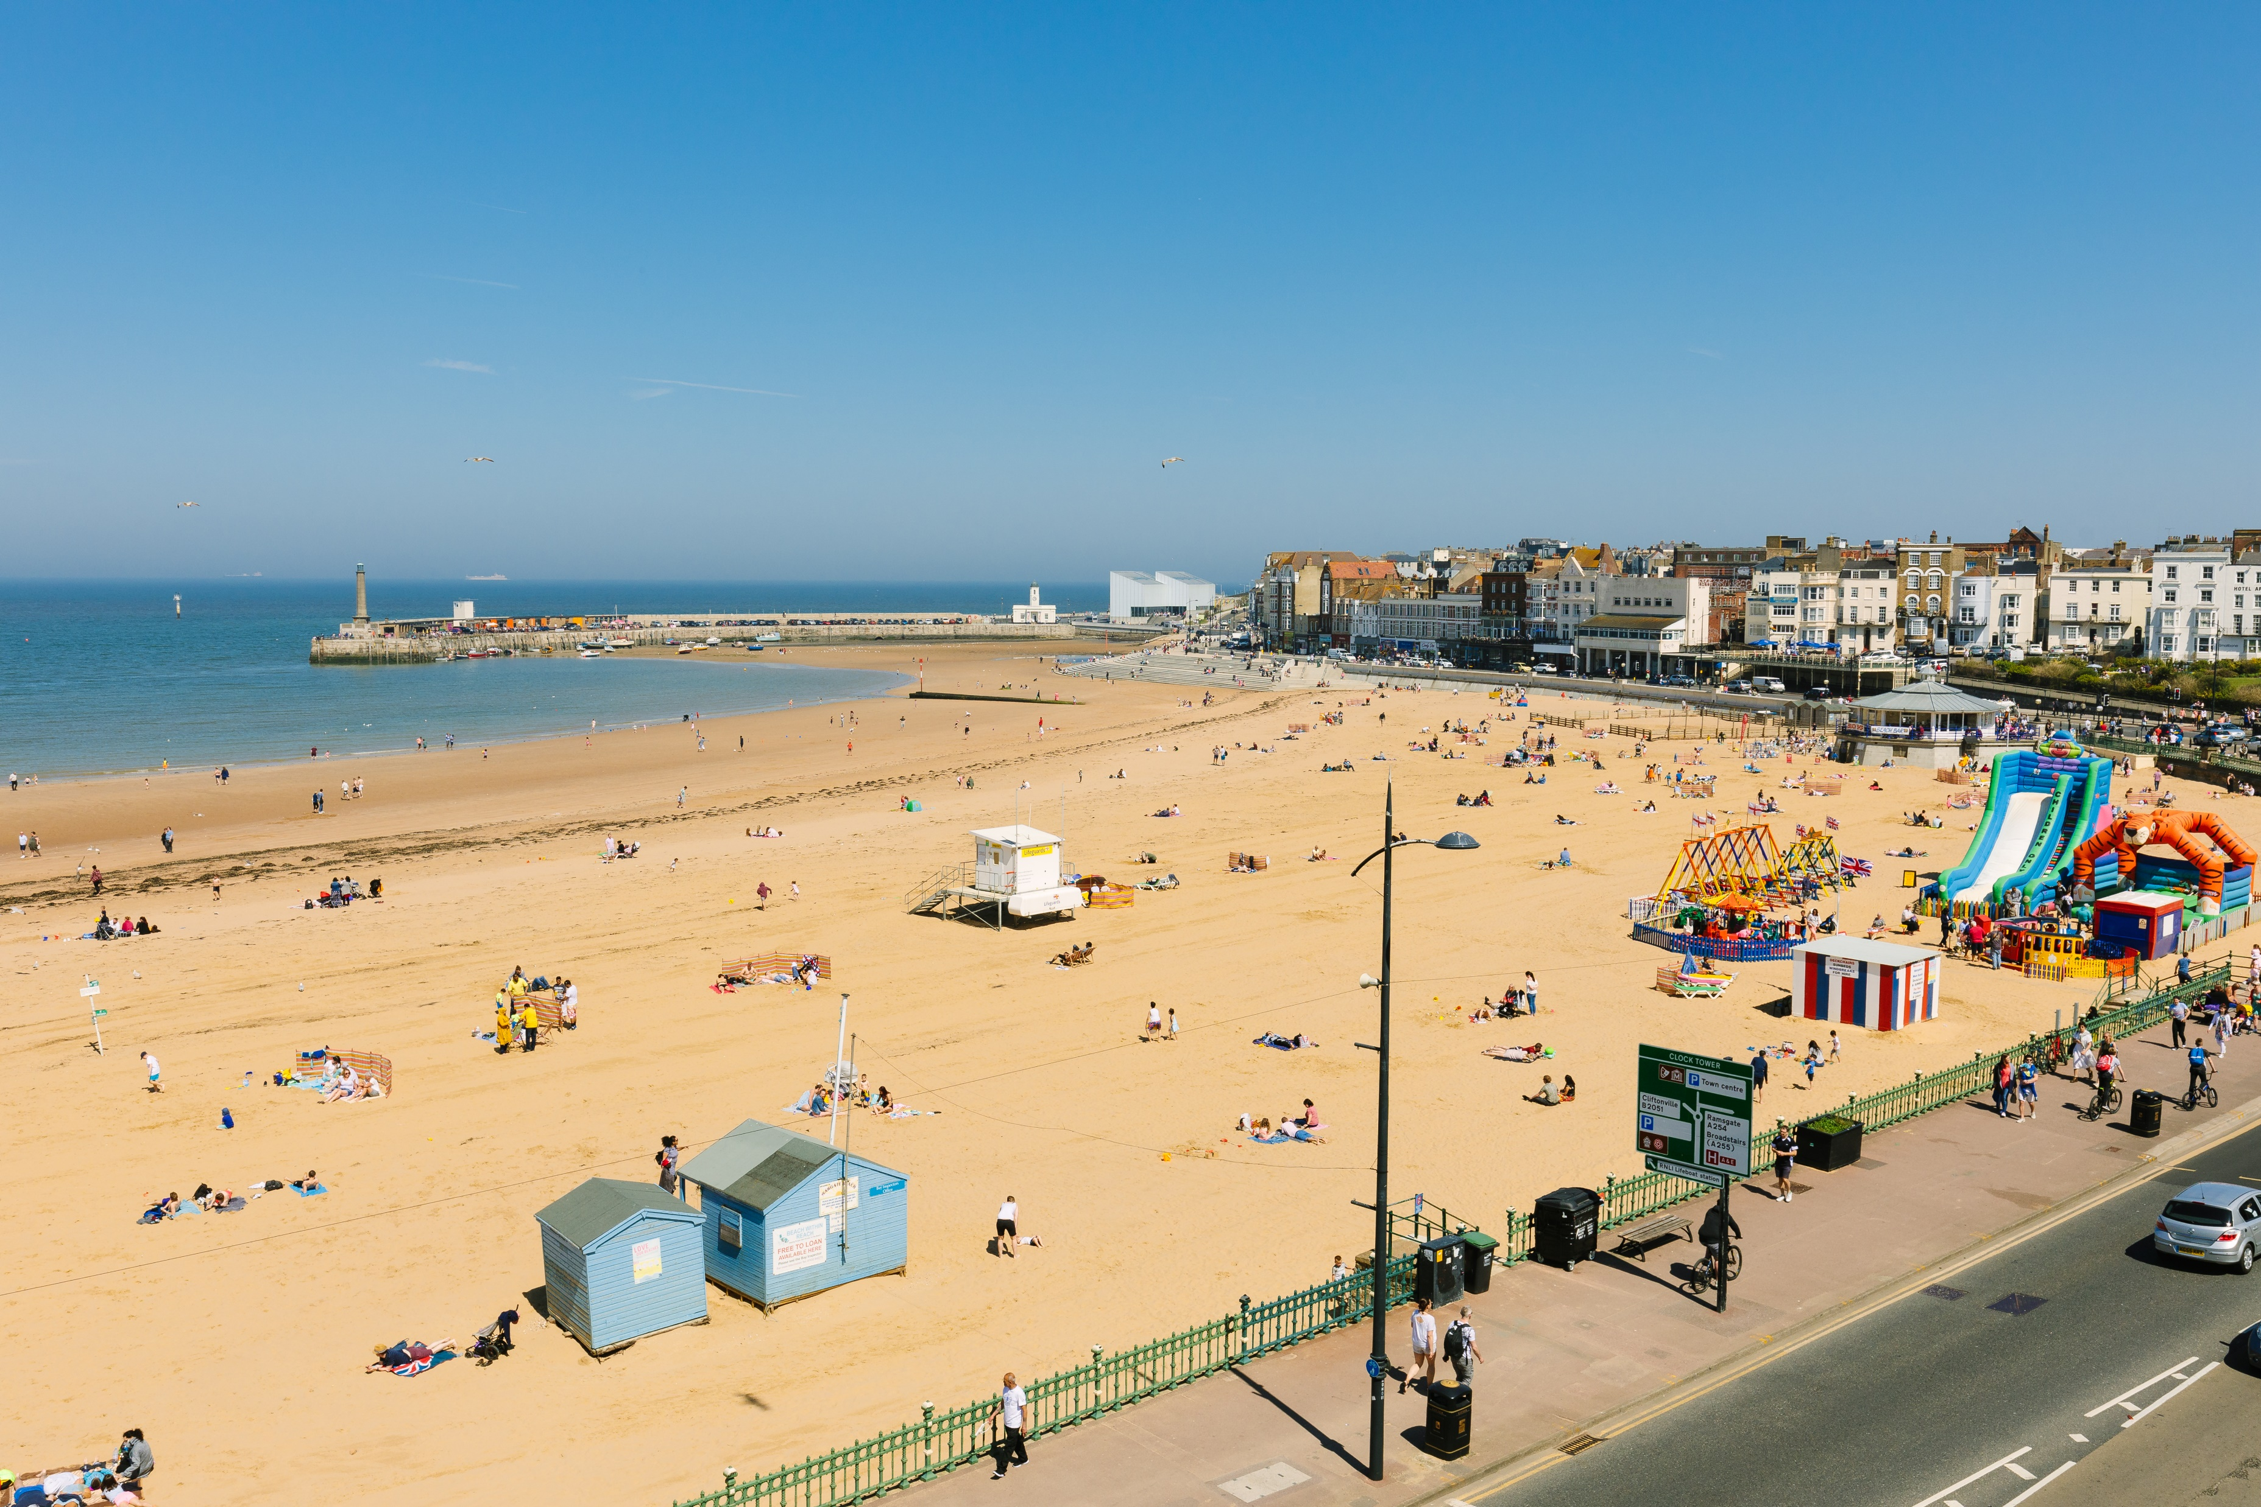
Thanet Visitor Survey - Report of Findings – Expenditure
Thanet Visitor Survey - Report of Findings – Trip Characteristics
Survey Findings – Expenditure levels
Credit: Thanet District Council
Credit: Thanet District Council
Page 42

Slide 43
Thanet Visitor Survey - Report of Findings – Expenditure
Thanet Visitor Survey - Report of Findings – Introduction
Trip expenditure
Day visitors | Thanet | Margate | Broadstairs | Ramsgate
Eating and drinking | £12.15 | £11.99 | £14.01 | £10.27
Shopping | £3.20 | £3.79 | £3.17 | £2.60
Entertainment | £2.26 | £4.27 | £1.05 | £1.35
Travel & transport | £7.10 | £8.49 | £6.93 | £5.05
Spend per day trip | £24.71 | £28.53 | £25.16 | £19.27
The average overall expenditure among staying visitors to Thanet (per person, per 24 hours) on accommodation, eating out, shopping, entertainment and travel and transport was £43.97. Accommodation and food and drink accounted for the highest proportion of the expenditure. The average overnight visit lasted 4.4 nights, meaning that the average expenditure per person and per overnight trip was £193.46. Day visitors from home spent an average of around £24.71 per person per day in the town, with eating out accounting for the highest proportion of expenditure.
Out of the three destinations, day visitors to Margate spent the highest during their visit (£28.53). Staying visitors to Broadstairs spent the most during their trip, due partly to the longer duration of their staying trips (5.2 nights). Ramsgate attracted a lower expenditure per trip (£170.98) and per night (£37.99).
Staying visitors | Thanet | Margate | Broadstairs | Ramsgate
Eating and drinking | £14.66 | £15.80 | £13.97 | £14.22
Shopping | £4.04 | £4.03 | £5.48 | £2.62
Entertainment | £3.97 | £7.21 | £3.08 | £1.63
Travel & transport | £7.05 | £8.74 | £4.83 | £7.60
All accommodation | £14.23 | £14.85 | £15.93 | £11.93
Spend per night | £43.97 | £50.63 | £43.28 | £37.99
Nights x trip | 4.4 | 3.6 | 5.2 | 4.5
Spend per trip | £193.46 | £182.26 | £225.08 | £170.98
Day visitors | Thanet | Margate | Broadstairs | Ramsgate
2018 | £24.71 | £28.53 | £25.16 | £19.27
2010 | £12.50 | £12.04 | £10.45 | £14.66
2010 (with inflation) | £15.74 | £15.15 | £13.25 | £18.36
2010 Research
Expenditure levels have gone up since 2010 even when accounting for inflation.
Spend per night | Thanet | Margate | Broadstairs | Ramsgate
2018 | £43.97 | £50.63 | £43.28 | £37.99
2010 | £28.52 | £32.58 | £28.77 | £23.95
2010 (with inflation) | £35.90 | £40.94 | £36.53 | £30.23
Base: 737 – open – How much has/will you and your party be spending on your accommodation for the duration of your stay (inclusive of breakfast)? Base: 1351 – open - Thinking about today as a whole, how much do you expect that you AND your immediate party will have spent today in total on the following?
Secondary Research
Supports Visit England’s view that England has seen significant growth, with record tourist spending reported in recent years from both domestic and international markets. – See Secondary Research Report, Page 4.
Page 43

Slide 44
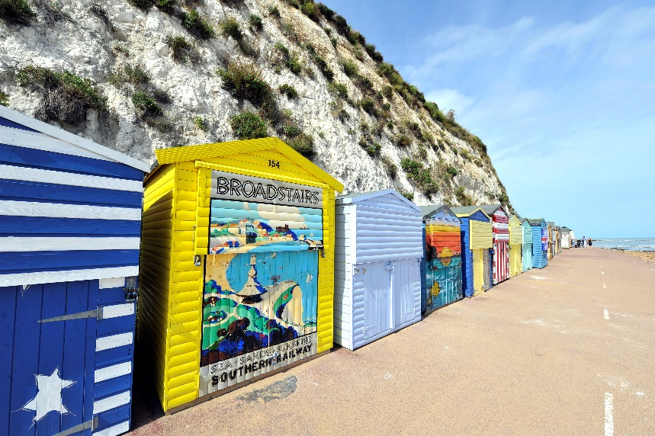
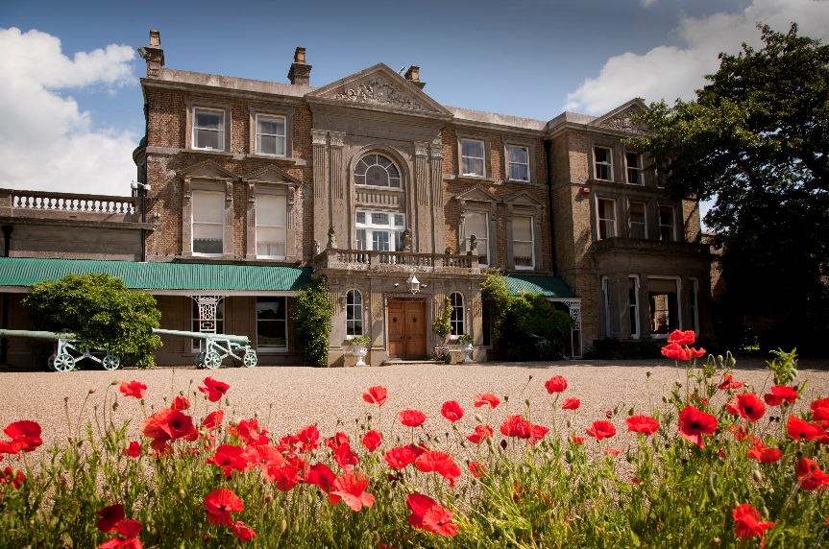
Thanet Visitor Survey - Report of Findings – Trip Influencers
Thanet Visitor Survey - Report of Findings – Trip Characteristics
Survey Findings – Trip influencers
Image Credit: Phil Houghton
Image Credit: Rod Edwards
Page 44

Slide 45
Thanet Visitor Survey - Report of Findings – Trip Influencers
Thanet Visitor Survey - Report of Findings – Introduction
Key influencers
The survey sought to obtain opinions on what were the key influencers when choosing Thanet as a place to visit for a leisure and holiday visit. Respondents were presented with a set list of options and asked to select the ones that influenced their decision making process. The coastline and beaches were the main influencer, selected by just over half of all respondents. The coastline and beaches were particularly important when choosing to visit Broadstairs (59%) and least important for visits to Margate (49%), which reinforces the strength of the product available in Margate. Recreational activities (water sports, walking, cycling, etc.) were particularly influential when choosing Ramsgate (34%), above the overall average of 30%.
The results of the survey show that almost a third (30%) of visitors to Margate selected attractions as a key influencer, above the average for the three towns (24%). Arts and culture also play a significant role in choosing to visit Margate, selected by 18%, which is double the average for Thanet (9%). There is a clear correlation between these responses and the proportion of visitors to Margate that had visited (or planed to visit) Dreamland and Turner Contemporary, as seen earlier in this report.
The seasonality analysis highlights some significant differences and also some opportunities. As you would expect, recreational activities are a stronger motivator during the summer period, as it is often linked to weather and also to younger audience during their school summer break. Attractions and arts and culture both achieved significantly higher scores during the autumn interview period which tells us that these activities can help promote future visits outside the main holiday season and encourage a more year-round tourism offer.
 | Thanet | Margate | Broadstairs | Ramsgate
Coastline/beaches | 53% | 47% | 59% | 54%
Attractions | 24% | 30% | 24% | 19%
Arts/culture | 9% | 18% | 5% | 5%
History/heritage | 6% | 5% | 8% | 6%
Recreational activities | 30% | 28% | 30% | 34%
Other | 9% | 4% | 9% | 13%
 | All visits | Summer | Autumn
Coastline/beaches | 53% | 55% | 52%
Attractions | 24% | 16% | 32%
Arts/culture | 9% | 4% | 15%
History/heritage | 6% | 5% | 8%
Recreational activities | 30% | 33% | 28%
Other | 9% | 10% | 7%
Secondary Research
Base: 1351 – prompted (multiple answers allowed) – Did any of the following factors influence your decision to visit?
The Visit Kent perception research (18) shows that Thanet is rated positively for its coastal and seaside destinations against competitors (Great Yarmouth, Scarborough, Folkstone and Brighton). Heritage, culture and outdoor activities are also associated with the area. – See Secondary Research Report, Pages 14 and 20.
Page 45

Slide 46
Thanet Visitor Survey - Report of Findings – Trip Influencers
Thanet Visitor Survey - Report of Findings – Introduction
Key influencers – Information – Planning stage
Three in five visitors (62%) had not searched for destination information pre-trip – instead, they relied on their previous knowledge (this is to be expected as 78% of respondents had visited previously – see page 38). Of those who did search for tourism information, 12% visited the destination website (the destination website was the most widely used by visitors to Broadstairs, selected by 14% of them).
Websites and search engines other than destination websites were selected by 10% of respondents to Thanet (this channel was slightly more prevalent in Margate, selected by 12% of the respondents). Destination websites were proportionally used more when planning out of season trips (14% in autumn compared to 10% for summer visits), highlighting the importance that this channel can play in attracting visitors outside the main school holiday period. Visitors to Ramsgate were the most likely to use brochures / leaflets (10%) and visitors to Margate were the least likely to use them (4%) as part of their trip planning preparations.
‘Other’ sources included primarily direct enquiries with visitor attractions (particularly with Dreamland and Turner Contemporary), communications from Southeastern, visits to the TICs as well as the use of visitor maps. A few also mention information from festival organisers (e.g. Soul Festival and the Canterbury festival).
 | Thanet | Margate | Broadstairs | Ramsgate
I did not use any information | 62% | 57% | 63% | 66%
Advertisement (Paper / Magazine/ TV / radio) | 2% | 3% | 1% | 1%
I visited the destination website | 12% | 12% | 14% | 10%
I visited other websites / search engine | 10% | 12% | 10% | 9%
I visited review websites (TripAdvisor etc) | 3% | 4% | 3% | 4%
I looked through Location brochures / leaflets | 8% | 4% | 8% | 10%
I looked for recommendations on social media | 2% | 3% | 3% | 1%
I asked friends for recommendations | 7% | 9% | 6% | 5%
Other | 5% | 7% | 5% | 2%
 | All visits | Summer | Autumn
I did not use any information | 62% | 57% | 67%
Advertisement (Paper / Magazine/ TV / radio) | 2% | 2% | 1%
I visited the destination website | 12% | 10% | 14%
I visited other websites / search engine | 10% | 10% | 10%
I visited review websites (TripAdvisor etc) | 3% | 4% | 3%
I looked through brochures / leaflets | 8% | 10% | 5%
I looked for recommendations on social media | 2% | 3% | 1%
I asked friends for recommendations | 7% | 8% | 5%
Other | 5% | 5% | 4%
Secondary Research
2010 Research
Base: 1351 – prompted – Thinking about how you planned this trip, which of the following applies to you?
Destination websites should consider emerging trends such as the ‘performance perfection’, with consumers seeking out destinations with photo and video opportunities. – See Secondary Research, Page 4.
Combined, destination websites, search engine and review sites accounted for 25% of all marketing consumption in 2018, up from 7% in 2010.
Page 46

Slide 47
Thanet Visitor Survey - Report of Findings – Trip Influencers
Thanet Visitor Survey - Report of Findings – Introduction
Key influencers – Information – During visit
Almost three quarters of visitors felt it was not necessary to use any information sources during their visit. Those who did, relied primarily on printed materials (8%), printed maps (8%) and the location website/social media (7%).
Interestingly, visitors to Broadstairs were more likely to use a visitor map (11%) and printed materials (10%). Conversely, visitors to Margate were the most likely to use the destination website and social media during their visit. This may be partly influenced by the higher proportion of young adults (16-24 age group) visiting Margate compared to Broadstairs’ more mature visiting population, as seen in the previous section of this report.
 | Thanet | Margate | Broadstairs | Ramsgate
Location website/social media | 7% | 10% | 6% | 4%
Travel guide website | 2% | 3% | 2% | 2%
Travel blogs | 0% | 0% | 0% | 1%
Apps | 0% | 0% | 0% | 0%
Other social media | 1% | 2% | 1% | 1%
Visitor Map | 8% | 4% | 11% | 8%
Printed material | 8% | 5% | 10% | 9%
TIC | 0% | 0% | 0% | 0%
Other | 1% | 1% | 1% | 1%
None | 77% | 77% | 75% | 79%
Base: 1351 – prompted – Did you use any other type of information during your visit?
Page 47

Slide 48
Thanet Visitor Survey - Report of Findings – Trip Influencers
Thanet Visitor Survey - Report of Findings – Visitor Profile
Additional Tables – Trip influencers
Trip influencers
Trip influencers - Seasonality
 | All visits | Margate | Broadstairs | Ramsgate
Base | 1351 | 450 | 451 | 450
Coastline/beaches | 53% | 47% | 59% | 54%
Attractions | 24% | 30% | 24% | 19%
Arts/culture | 9% | 18% | 5% | 5%
History/heritage | 6% | 5% | 8% | 6%
Recreational activities | 30% | 28% | 30% | 34%
Other | 9% | 4% | 9% | 13%
 | All visits | Summer | Autumn
Base | 1351 | 669 | 682
Coastline/beaches | 53% | 55% | 52%
Attractions | 24% | 16% | 32%
Arts/culture | 9% | 4% | 15%
History/heritage | 6% | 5% | 8%
Recreational activities | 30% | 33% | 28%
Other | 9% | 10% | 7%
Information used when planning trip
Information used when planning trip - Seasonality
 | All visits | Margate | Broadstairs | Ramsgate
Base | 1351 | 450 | 451 | 450
I did not use any information | 62% | 57% | 63% | 66%
Advertisement (Paper / Magazine/ TV / radio) | 2% | 3% | 1% | 1%
I visited the destination website | 12% | 12% | 14% | 10%
I visited other websites / search engine | 10% | 12% | 10% | 9%
I visited review websites (TripAdvisor etc) | 3% | 4% | 3% | 4%
I looked through Location brochures / leaflets | 8% | 4% | 8% | 10%
I looked for recommendations on social media | 2% | 3% | 3% | 1%
I asked friends for recommendations | 7% | 9% | 6% | 5%
Other | 5% | 7% | 5% | 2%
 | All visits | Summer | Autumn
Base | 1351 | 669 | 682
I did not use any information | 62% | 57% | 67%
Advertisement (Paper / Magazine/ TV / radio) | 2% | 2% | 1%
I visited the destination website | 12% | 10% | 14%
I visited other websites / search engine | 10% | 10% | 10%
I visited review websites (TripAdvisor etc) | 3% | 4% | 3%
I looked through brochures / leaflets | 8% | 10% | 5%
I looked for recommendations on social media | 2% | 3% | 1%
I asked friends for recommendations | 7% | 8% | 5%
Other | 5% | 5% | 4%
Page 48

Slide 49
Thanet Visitor Survey - Report of Findings – Trip Influencers
Thanet Visitor Survey - Report of Findings – Visitor Profile
Additional Tables – Trip influencers
Information used when planning trip
Information used when planning trip - Seasonality
 | Thanet | Margate | Broadstairs | Ramsgate
Base | 1351 | 450 | 451 | 450
Location website/social media | 7% | 10% | 6% | 4%
Travel guide website | 2% | 3% | 2% | 2%
Travel blogs | 0% | 0% | 0% | 1%
Apps | 0% | 0% | 0% | 0%
Other social media | 1% | 2% | 1% | 1%
Visitors Map | 8% | 4% | 11% | 8%
Printed material | 8% | 5% | 10% | 9%
TIC | 0% | 0% | 0% | 0%
Other | 1% | 1% | 1% | 1%
None | 77% | 77% | 75% | 79%
 | All responses | Summer | Autumn
Base | 1351 | 669 | 682
Location website/social media | 7% | 7% | 6%
Travel guide website | 2% | 2% | 3%
Travel blogs | 0% | 0% | 1%
Apps | 0% | 0% | 1%
Other social media | 1% | 1% | 1%
Visitors Map | 8% | 6% | 9%
Printed material | 8% | 7% | 9%
TIC | 0% | 0% | 0%
Other | 1% | 1% | 1%
None | 77% | 78% | 76%
Page 49

Slide 50
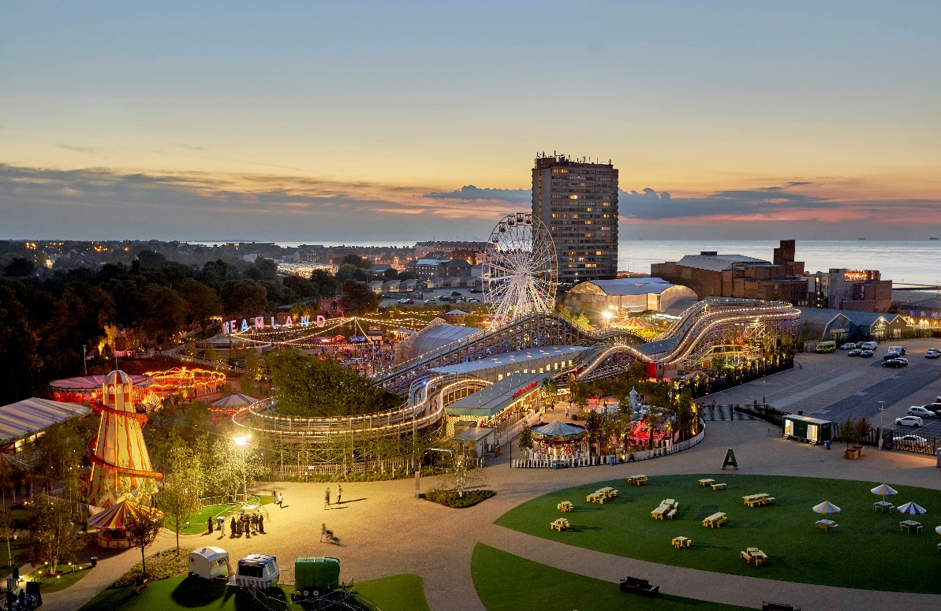
Thanet Visitor Survey - Report of Findings – Visitor Satisfaction
Thanet Visitor Survey - Report of Findings – Trip Characteristics
Survey Findings – Satisfaction scores
Image Credit: Dreamland, Margate
Page 50

Slide 51
Thanet Visitor Survey - Report of Findings – Visitor Satisfaction
Thanet Visitor Survey - Report of Findings – Introduction
Visitor Satisfaction – Satisfaction scores
The survey obtained the opinions of visitors to Thanet on a range of indicators which together comprise the ‘visitor experience’. Each indicator was rated on a scale of one to five, where 1 = ‘very poor’ and 5=‘very good’, allowing satisfaction scores to be calculated.
The ease of finding your way around the towns achieved the highest score (4.68 out of 5), followed by beach related activities, including the quality of beach experiences (4.56) and beach / coastline cleanliness (4.52). It is significant that beach related activities achieved such high scores taking into account that the coastline and beaches were the main influencer when deciding to visit Thanet.
The scores for shopping, and toilets (for both availability and cleanliness), achieved lower scores and were the only indicators to score below four out or five.
Secondary Research
Base: 1351 – prompted – Please rate your satisfaction level on the following aspects of your visit.
These high satisfaction scores would support the findings from VisitEngland’s Kent Destination report (24), which shows that when looking at visitor satisfaction, the Kent coast was rated higher than that of the country average . – See Secondary Research Report, Page 17.
Page 51

Slide 52
Thanet Visitor Survey - Report of Findings – Visitor Satisfaction
Thanet Visitor Survey - Report of Findings – Introduction
Visitor Satisfaction – Satisfaction scores
 | All visits | Summer | Autumn | Difference
Ease of finding your way around | 4.68 | 4.78 | 4.59 | 0.19
Quality of beach experiences | 4.56 | 4.51 | 4.60 | -0.10
Beach / coastline cleanliness | 4.52 | 4.46 | 4.57 | -0.11
Places to eat and drink | 4.51 | 4.47 | 4.54 | -0.08
Feeling of welcome | 4.50 | 4.45 | 4.55 | -0.10
Maps and information boards | 4.45 | 4.49 | 4.43 | 0.06
History & Heritage | 4.42 | 4.44 | 4.42 | 0.02
Watersports / outdoor recreation | 4.39 | 4.39 | 4.39 | -0.01
General atmosphere | 4.39 | 4.34 | 4.43 | -0.09
Pedestrian signposting | 4.36 | 4.19 | 4.51 | -0.32
Prams / buggies access | 4.27 | 4.25 | 4.28 | -0.03
Arts and culture | 4.24 | 4.26 | 4.21 | 0.05
Disabled accessibility | 4.22 | 4.20 | 4.23 | -0.04
Attractions | 4.13 | 4.15 | 4.11 | 0.04
Traffic levels / congestion | 4.13 | 3.89 | 4.36 | -0.47
Shops | 3.52 | 3.52 | 3.51 | 0.00
Public toilets - availability | 3.41 | 3.42 | 3.39 | 0.04
Public toilets - cleanliness | 3.11 | 2.88 | 3.37 | -0.49
The seasonality analysis highlights some significant differences, especially in relation to accessibility. Scores for ‘Ease of finding your way around’ were higher in summer (4.78) than in autumn (4.59), making the summer score the overall highest score for all indicators and seasons. This, combined with the higher summer score for ‘Maps and information boards’ (4.49 in summer and 4.43 in autumn) could be interpreted as suggesting that information provision might be more readily available during the main tourism season.
There were three indicators that stood out within the set of score for autumn visits. For example, whilst it is unlikely that the actual pedestrian signposting would have changed physically between summer and autumn, it is possible that the reduction in the volume of visitors following the end of the school summer period made the pedestrian signposting more visible to the visitors. This likely reduction in the volume of visitors may also explain the difference in score for ‘traffic levels / congestion’ (4.36 in autumn and 3.89 in summer) and the cleanliness of public toilets (3.37 in autumn against a lower 2.88 in summer), linked to a reduced usage of the facilities.
Secondary Research
Base: 1351 – prompted – Please rate your satisfaction level on the following aspects of your visit.
The high scores for ‘feeling of welcome’ buck a national of a steady decline (25). High scores for ‘Ease of finding your way around’ and beach / coastline are in line with the top perceptions for Thanet (Visit Kent Perception research report). – See Secondary Research Report, Pages 18 and 20.
Page 52

Slide 53
Thanet Visitor Survey - Report of Findings – Visitor Satisfaction
Thanet Visitor Survey - Report of Findings – Introduction
Visitor Satisfaction – Satisfaction scores
At destination level, Broadstairs achieved the highest average score for all indicators combined (4.27 out of 5). Ramsgate came a close second (4.20) and Margate was last (4.16).
Broadstairs achieved the highest scores for 11 out of a total of 17 indicators, including a 4.59 score for ‘General atmosphere’ and 4.67 for ‘Feeling of welcome’.
Ramsgate achieved highest scores for public toilet facilities, both in terms of availability (3.63) and cleanliness (3.29) and for ‘Traffic levels / congestion’ (4.24) and ‘Pedestrian signposting’ (4.38).
Margate achieved the lowest scores for 8 indicators, with ‘History & Heritage’ and ‘Places to eat and drink’ being particularly low (4.25 and 4.37 respectively) when compared to Broadstairs (4.55 and 4.61 respectively) and Ramsgate (4.45 and 4.53 respectively).
However, Margate also achieved the highest score for ‘arts and culture’ (4.33) which is likely to be influenced by the presence of Turner Contemporary. Margate also achieved the highest scores for indicators linked to accessibility, with a 4.34 score for both ‘Disabled accessibility’ and for ‘Prams / buggies access’.
 | Thanet | Margate | Broadstairs | Ramsgate
Overall average | 4.21 | 4.16 | 4.27 | 4.20
Ease of finding your way around | 4.68 | 4.62 | 4.75 | 4.67
Quality of beach experiences | 4.56 | 4.49 | 4.64 | 4.53
Beach / coastline cleanliness | 4.52 | 4.44 | 4.61 | 4.48
Maps and information boards | 4.45 | 4.38 | 4.55 | 4.42
Feeling of welcome | 4.50 | 4.38 | 4.67 | 4.46
Places to eat and drink | 4.51 | 4.37 | 4.61 | 4.53
Pedestrian signposting | 4.36 | 4.36 | 4.33 | 4.38
Disabled accessibility | 4.22 | 4.34 | 4.11 | 4.21
Prams / buggies access | 4.27 | 4.34 | 4.19 | 4.30
Watersports / outdoor recreation | 4.39 | 4.33 | 4.50 | 4.35
Arts and culture | 4.24 | 4.33 | 4.31 | 4.06
General atmosphere | 4.39 | 4.29 | 4.59 | 4.29
History & Heritage | 4.42 | 4.25 | 4.55 | 4.45
Traffic levels / congestion | 4.13 | 4.17 | 3.97 | 4.24
Attractions | 4.13 | 4.07 | 4.27 | 4.05
Shops | 3.52 | 3.33 | 3.91 | 3.28
Public toilets - availability | 3.41 | 3.28 | 3.28 | 3.63
Public toilets - cleanliness | 3.11 | 3.07 | 2.96 | 3.29
Base: 1351 – prompted – Please rate your satisfaction level on the following aspects of your visit.
Page 53

Slide 54
Thanet Visitor Survey - Report of Findings – Visitor Satisfaction
Thanet Visitor Survey - Report of Findings – Introduction
Overall enjoyment and likelihood of recommending
2010 Research
The satisfaction scores were very positive with visitors to both individual destinations, as well as at the district level scoring highly the enjoyment and likelihood to recommend (over 4 out of 5).
Autumn visitors enjoyed their visit more than those visiting in the summer. As a result, autumn visitors are more likely to recommend the area to others. The same pattern applies at destination level. This is a very interesting aspect, which can be interpreted from various angles – i.e. the type of visitors, the differences in numbers of visitors between the two seasons.
Score for the overall enjoyment with visits was up from 3.77 in 2010 to 4.36 in 2018.
Likelihood of recommending also up but less pronounced (4.04 in 2010 to 4.32 in 2018)
Base: 1351 – prompted – Please rate your satisfaction level on the following aspects of your visit.
Page 54

Slide 55
Thanet Visitor Survey - Report of Findings – Visitor Profile
Thanet Visitor Survey - Report of Findings – Visitor Satisfaction
Additional Tables – Satisfaction scores
Seasonality - Overall enjoyment
 | All visits | Summer | Autumn
Base | 1351 | 669 | 682
Thanet | 4.36 | 4.32 | 4.41
Margate | 4.27 | 4.2 | 4.3
Broadstairs | 4.53 | 4.55 | 4.49
Ramsgate | 4.29 | 4.12 | 4.43
Overall enjoyment / likelihood of recommending
 | Overall enjoyment | Likelihood of recommending
Base | 1351 | 1351
Thanet | 4.36 | 4.32
Margate | 4.27 | 4.26
Broadstairs | 4.53 | 4.60
Ramsgate | 4.29 | 4.21
Seasonality - Likelihood of recommending
 | All visits | Summer | Autumn
Base | 1351 | 669 | 682
Thanet | 4.32 | 4.19 | 4.47
Margate | 4.26 | 4.17 | 4.39
Broadstairs | 4.6 | 4.54 | 4.64
Ramsgate | 4.21 | 3.92 | 4.51
Page 55

Slide 56
Thanet Visitor Survey - Report of Findings – Visitor Satisfaction
Thanet Visitor Survey - Report of Findings – Visitor Profile
Additional Tables – Satisfaction scores
Overall enjoyment – Summer
 | Thanet | Margate | Broadstairs | Ramsgate
Base | 669 | 225 | 226 | 218
Very high | 41% | 37% | 57% | 27%
High | 51% | 50% | 41% | 62%
Average | 7% | 10% | 2% | 9%
Low | 1% | 2% | 0% | 1%
Very low | 0% | 1% | 0% | 0%
Don't know | 0% | 0% | 0% | 0%
Score | 4.32 | 4.2 | 4.55 | 4.12
Overall enjoyment – All visitors
 | Thanet | Margate | Broadstairs | Ramsgate
Base | 1351 | 450 | 451 | 450
Very high | 44% | 41% | 55% | 37%
High | 49% | 47% | 43% | 56%
Average | 6% | 10% | 2% | 6%
Low | 1% | 2% | 0% | 1%
Very low | 0% | 0% | 0% | 0%
Don't know | 0% | 0% | 0% | 0%
Score | 4.36 | 4.27 | 4.53 | 4.29
Overall enjoyment – Autumn
 | Thanet | Margate | Broadstairs | Ramsgate
Base | 682 | 225 | 225 | 232
Very high | 48% | 44% | 52% | 47%
High | 46% | 44% | 45% | 49%
Average | 5% | 10% | 3% | 4%
Low | 1% | 2% | 0% | 0%
Very low | 0% | 0% | 0% | 0%
Don't know | 0% | 0% | 0% | 0%
 | 4.41 | 4.3 | 4.49 | 4.43
Page 56

Slide 57
Thanet Visitor Survey - Report of Findings – Visitor Satisfaction
Thanet Visitor Survey - Report of Findings – Visitor Profile
Additional Tables – Satisfaction scores
Likelihood of recommending – Summer
 | Thanet | Margate | Broadstairs | Ramsgate
Base | 669 | 225 | 226 | 218
Very likely | 49% | 45% | 67% | 36%
Likely | 35% | 38% | 26% | 42%
Average | 9% | 10% | 5% | 11%
Unlikely | 3% | 4% | 0% | 5%
Very unlikely | 1% | 2% | 0 | 1%
Don't know | 3% | 1% | 2% | 5%
Score | 4.19 | 4.17 | 4.54 | 3.92
Likelihood of recommending – All visitors
 | Thanet | Margate | Broadstairs | Ramsgate
Base | 1351 | 450 | 451 | 450
Very likely | 53% | 48% | 67% | 46%
Likely | 36% | 38% | 29% | 41%
Average | 6% | 9% | 3% | 7%
Unlikely | 2% | 3% | 0% | 3%
Very unlikely | 1% | 1% | 0% | 0%
Don't know | 2% | 1% | 1% | 2%
Score | 4.32 | 4.26 | 4.6 | 4.21
Likelihood of recommending – Autumn
 | Thanet | Margate | Broadstairs | Ramsgate
Base | 682 | 225 | 225 | 232
Very likely | 57% | 51% | 66% | 56%
Likely | 37% | 39% | 32% | 40%
Average | 4% | 8% | 2% | 3%
Unlikely | 1% | 2% | 0% | 1%
Very unlikely | 0% | 0% | 0% | 0%
Don't know | 0% | 1% | 0% | 0%
Score | 4.47 | 4.39 | 4.64 | 4.51
Page 57

Slide 58
Thanet Visitor Survey - Report of Findings – Challenges and Opportunities
Thanet Visitor Survey - Report of Findings – Introduction
Opportunities and Challenges for Margate
The best things about Margate according to visitors have been grouped into key themes. Most respondents mentioned the beach as the best thing about Margate and generally being by the sea. Combined, the coastal theme was mentioned in 281 instances. Entertainment, the arts and culture were also mentioned (132 times). In particular, respondents made reference to the Turner Contemporary and Dreamland. Some also mentioned the Soul Festival. Finally, a third theme related to the friendly atmosphere of the place, including the old town.
The challenging things about Margate have also been grouped into key themes. The main criticism relates to the area still being a bit run down, including some derelict and neglected buildings, as well as references to the lack of cleanliness and the presence of litter. Retail outlets were also highlighted as a problem, in particular the number of empty shops, the limited choice and opening times (some object to shops being closed on Mondays). Finally, the poor cleanliness and limited availability of public conveniences were also raised.
The beaches and the seaside (281)
Run down, litter (115)
Arts, culture and entertainment (132)
Town centre, friendly atmosphere (51)
Empty shops (54)
Toilets (22)
Secondary Research
Base: 1351 – open – The best thing about Margate is…? – The worst thing about Margate is..?
According to the Visit Kent Perception research (18) Margate scored highly in terms of having a range of attractions and things to do, alongside having beautiful beaches. The same study mentions a shift towards a more cultural destination. – See Secondary Research Report, Page 20.
Page 58

Slide 59
Thanet Visitor Survey - Report of Findings – Challenges and Opportunities
Thanet Visitor Survey - Report of Findings – Introduction
Opportunities and Challenges for Broadstairs
Most respondents mentioned the beach as the best thing about Broadstairs, in particular they mentioned the sandy beaches, the promenade and the sea views. This in turn is linked to opportunities for walking and amenities for kids. as well as the range of ice cream parlours and kiosks. A second theme was related to the good atmosphere of the place and the friendliness of people (locals and visitors). Finally, Broadstairs itself is mentioned for its traditional, picturesque and quaint aspects, with a few references to the history and the Dickens Festival.
The challenging things about Broadstairs relate mainly to the presence of litter and general cleanliness. This also extends to the poor cleanliness of the public toilets. Many visitors to Broadstairs mentioned car parking and particularly the high costs of using the town centre car parks (as identified in the transport section of this report, in particular the low scores for availability and cost of parking). This broad theme relates to accessibility and congestion, partly due to the high volume of traffic and because the area feels busy and at times crowded. This also creates access problems for buggies (e.g. in shops and the boardwalk on the beach) as identified in the satisfaction scores section of this report.
The beach and seaside (263)
General cleanliness and toilet facilities (118)
Friendly atmosphere (105)
Town aspect and eateries (88)
Car parks (cost and availability) (74)
Accessibility (47)
Base: 1351 – open – The best thing about Broadstairs is…? – The worst thing about Broadstairs is..?
Page 59

Slide 60
Thanet Visitor Survey - Report of Findings – Challenges and Opportunities
Thanet Visitor Survey - Report of Findings – Introduction
Opportunities and Challenges for Ramsgate
The best things about Ramsgate link mostly to the harbour and the clean, sandy beach. Some respondents also linked the harbour area to the presence of good pubs and restaurants as well as the opportunity for waking and cycling as well as having a friendly atmosphere. A second theme related to the general look of the town, which many described as being nice, old and picturesque with old building and interesting architecture.
When it comes to Ramsgate, there is a marked difference between the harbour and the town centre. The main criticism relates to Ramsgate’s town centre. It is often described as being a bit run down, with the presence of litter and references to the general lack of cleanliness and dirty pavements. The cost of parking in the town centre as well as the the shopping environment (some shops looking run down, shop closures) were also mentioned by some as the worst aspect of the town.
The harbour and beach area (313)
Town centre - Run down, litter (106)
Town aspect / architecture (118)
Atmosphere around harbour area (40)
Car parks (39)
Shops (30)
Base: 1351 – open – The best thing about Ramsgate is…? – The worst thing about Ramsgate is..?
Page 60

Slide 61
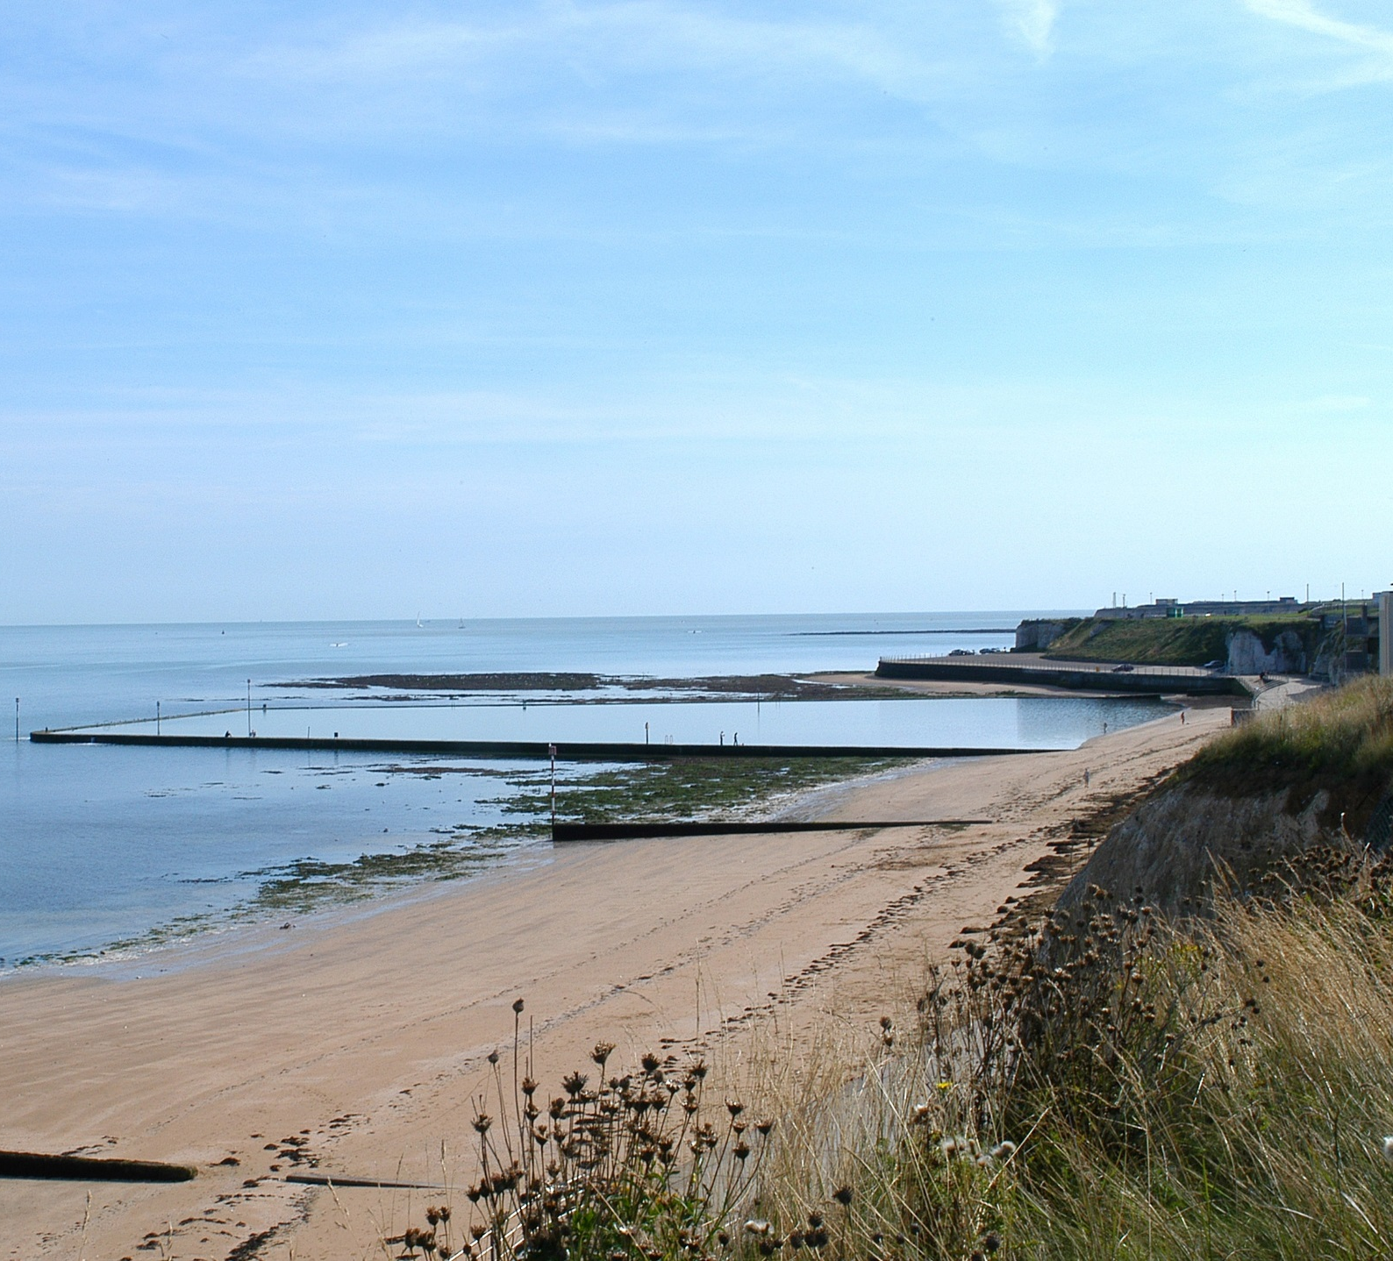
Thanet Visitor Survey – Interpretation and Recommendations
Thanet Visitor Survey - Report of Findings – Trip Characteristics
Interpretation and recommendations for individual towns within Thanet
Image Credit: Thanet District Council
Page 61

Slide 62
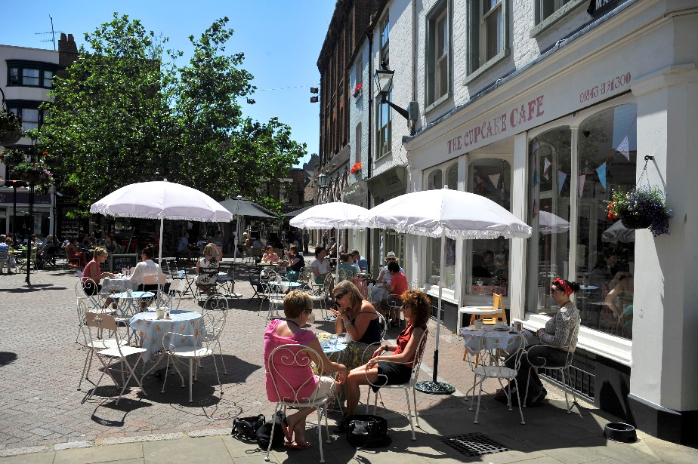
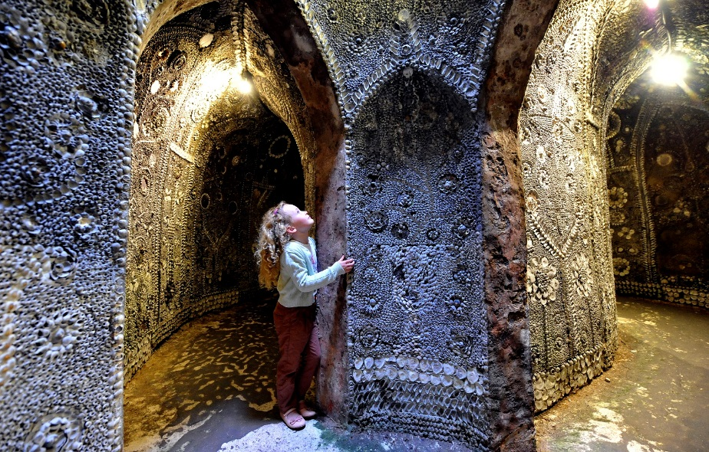
Thanet Visitor Survey – Interpretation and Recommendations
Thanet Visitor Survey - Report of Findings – Introduction
How to connect with visitors to Margate?
Younger visitors
Travel by train
Serviced accommodation and Airbnb
High levels of expenditure on accommodation and on entertainment
Attractions and arts & culture biggest triggers for visitation
Higher usage of destination websites and social media
WHO
Visits to Margate often comprise of younger visiting groups - 25% are under 24s and 10% fall under, in the 16-24 age group. Overall, 53% of visitors are under 45s. Margate attracts the highest proportion of visitors in employment (73%) and lowest proportion of retired visitors (21%)
Margate attracts a higher proportion of first-time visitors (25% compared to 22% for Thanet as a whole). It also attracts a slightly higher proportion of visits by groups of friends, students and those travelling alone (31% compared to 27% for Thanet).
HOW
Most arrive by car but visitors to Margate are significantly more likely to travel by train (30% compared to 19% for Thanet). The lower car usage results in the highest scores for availability of cost of parking
Overnight visitors are more likely to stay in Margate itself (30% compared to 27% for Thanet). Higher proportions of overnight visitors will stay in serviced accommodation establishments (39% stayed in hotels or B&Bs) or self-catering, specially via Airbnb (16%). Accommodation providers in Margate achieve the highest scores for quality of service and value for money.
HOW MUCH
This choice of accommodation results in a shorter duration of trip (3.6 nights per trip) but the highest spend per night (£50.63) compared to the average for the three towns (£43.97), driven by higher spend on accommodation but particularly on entertainment (£7.21 per person compared to £3.97 for Thanet).
Page 62

Slide 63
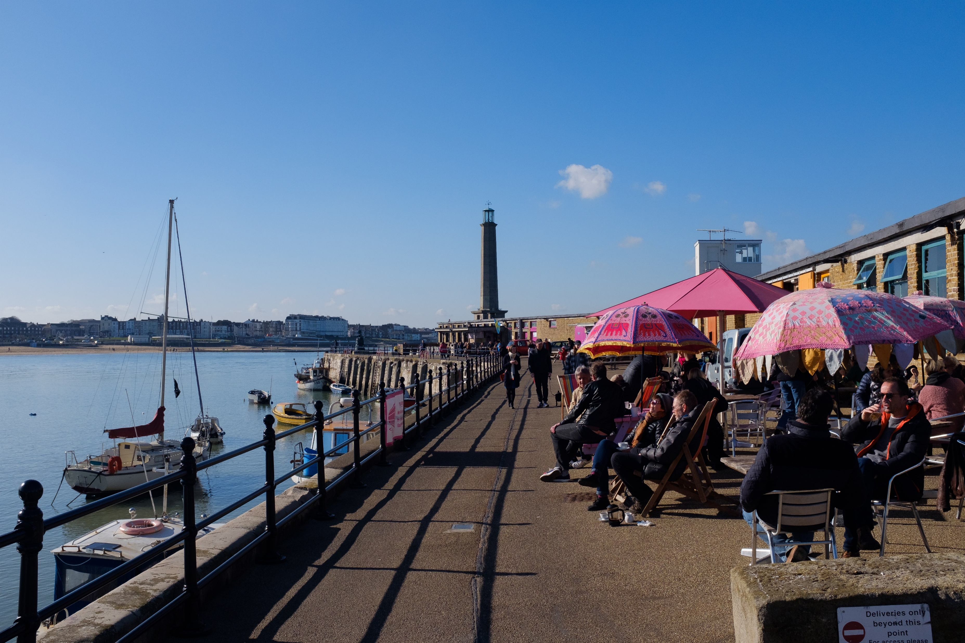
Thanet Visitor Survey – Interpretation and Recommendations
Thanet Visitor Survey - Report of Findings – Introduction
How to connect with visitors to Margate?
WHAT
Visitor attractions and arts and culture are the two biggest influencers when deciding to visit Margate. Not surprisingly, almost half (47%) had or planned to visit Turner Contemporary and a third (34%) had visited Dreamland (or intended to do so), which are the biggest triggers for visitation.
Visitors to Margate will use destination websites and other websites / search engines when planning their trips but will also rely on recommendations from friends and relatives. Once in Margate, they are the most likely to use the destination’s website and social media channels.
CONNECT:
Promote rail links – but remember this will encourage more day visitation
Ensure quality of accommodation remains high
Support additional accommodation
Maximise the potential of Turner Contemporary and Dreamland as triggers for future visitation
Promote events and harness the opportunities provided by Margate as a dynamic destination
Make sure destination websites and social media have the latest and most up to date information about things to do in Margate
Use influencers to inspire visitation
Use a tone of voice according to the visitor profile
Credit: Thanet District Council
Page 63

Slide 64
Thanet Visitor Survey – Interpretation and Recommendations
Thanet Visitor Survey - Report of Findings – Introduction
How to connect with visitors to Broadstairs?
Older visitors, family groups and specialist / interest groups
High proportion of retired visitors and from ABC1 socio-economic groups
Travel by car but dissatisfied with availability and cost of parking
Self catering accommodation booked directly with providers
High levels of expenditure on accommodation and shopping
Likely to visit Ramsgate but less likely to visit Margate as part of their trip
WHO
Broadstairs is popular with family groups (including intergenerational and extended families. It attracts the highest proportion of children (18% under 15 years old) and was the only destination reporting visits from specialist and interest groups. As a result, it attracts the largest visiting groups (2.71 people).
Visitors to Broadstairs aged 55+ account for 42% and 25% are over 65+, meaning that there is a high proportion of retired visitors (35%). Almost three quarters (71%) were classed as ABC1, the highest of the three towns. Broadstairs attracts a higher proportion of repeat visitors (80% compared to 78% for Thanet as a whole).
HOW
Most arrive by car but visitors to Broadstairs will also travel by train (16% compared to 19% for Thanet). There is potential to encourage higher usage of railways, especially as parking in town is rated below average for availability (3.9 compared to 4.2 for Thanet) and for the cost of parking (2.3 compared to 2.7 for Thanet). Many respondents also name congestion and the high volume of traffic.
High numbers of visitors to Broadstairs are likely to also visit Ramsgate during their trip. Overnight visitors are more likely to stay in self catering accommodation establishments and they are likely to book directly with accommodation providers.
HOW MUCH
This choice of accommodation results in the longest length of stay (5.2 nights per trip) and the highest spend per trip (£225.05, compared to £193.46 for Thanet). This higher spend is also triggered by a spike in shopping. Not surprisingly, shopping achieves the highest satisfaction scores (3.91) compared to Thanet as a whole (3.52).
Page 64

Slide 65
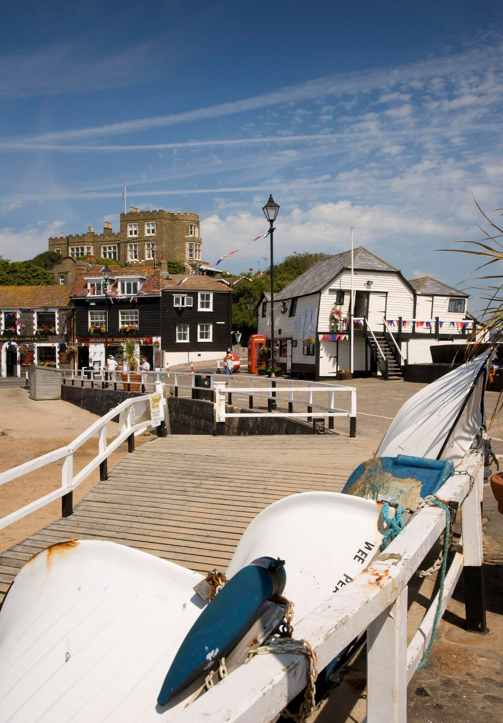
Thanet Visitor Survey – Interpretation and Recommendations
Thanet Visitor Survey - Report of Findings – Introduction
How to connect with visitors to Broadstairs?
WHAT
The beach and history & heritage are the two biggest influencers when deciding to visit Broadstairs. Things to do for families with children will attract visitors as well as information about places to eat or to have an ice cream.
Visitors to Broadstairs use destination websites to a smaller degree. Once in Broadstairs, they will rely on visitor maps and printed materials. Therefore, ensuring a good distribution of this type of promotional materials is essential.
CONNECT:
Promote rail links, specially as many are dissatisfied with parking and levels of congestion
Encourage accommodation providers to offer online bookability options
Consider joint promotion of Broadstairs and Ramsgate as many will visit both locations during their trip
Promote the beach, places to eat (including ice creams) and activities for kids
Ensure a good supply and availability of maps and printed materials for visitors
Support additional accommodation
Use a tone of voice according to the visitor profile
Page 65

Slide 66
Thanet Visitor Survey – Interpretation and Recommendations
Thanet Visitor Survey - Report of Findings – Introduction
How to connect with visitors to Ramsgate?
Older couples
High proportion of recent repeat visitors
Travel by car and a few by boat
Stay with friends and relatives with low expenditure per trip
Recreational activities are the biggest triggers for visitation
Higher usage of leaflets and brochures.
WHO
Visitors to Ramsgate are more likely to be couples (40% compared to 36% for Thanet) and the least likely to attract family units (22% compared to 27% for Thanet).
Ramsgate attracts a lower proportion of children (13%) and young adults (16-24s account for 5%), whereas those aged 55+ account for 46% and 28% are over 65+ (the highest percentages of the three towns). As a result, Ramsgate attracts the highest proportion of retired visitors (37%).
Ramsgate attracts a higher proportion regular(78%) and recent (42%,visited in the last six months).
HOW
Most arrive by car (the highest for the three towns) and a few (2%) arrived by boat. Although boat users are a minority this is a form of transport that could be promoted, not least because the harbour was identified as the best thing about Ramsgate.
High numbers of visitors to Ramsgate are likely to also visit Broadstairs during their trip. Day trips tend to be shorter than average (23% of visits lasted haft a day only, compared to an average of 20% for Thanet) and, as a result, spend per day trip is also the lowest (£19.27 compared to £24.71 for Thanet). Overnight visitors are more likely to visit and stay with friends and relatives. Those using paid accommodation are likely to stay in hotels and self catering units and likely to book directly with accommodation providers.
HOW MUCH
This higher proportion of visitors staying with friend and relatives results in the lowest spend per overnight trip (£170.98) and per night £37.99, compared to £43.97 for Thanet). Spend on shopping and entertainment is also proportionally low.
Page 66

Slide 67
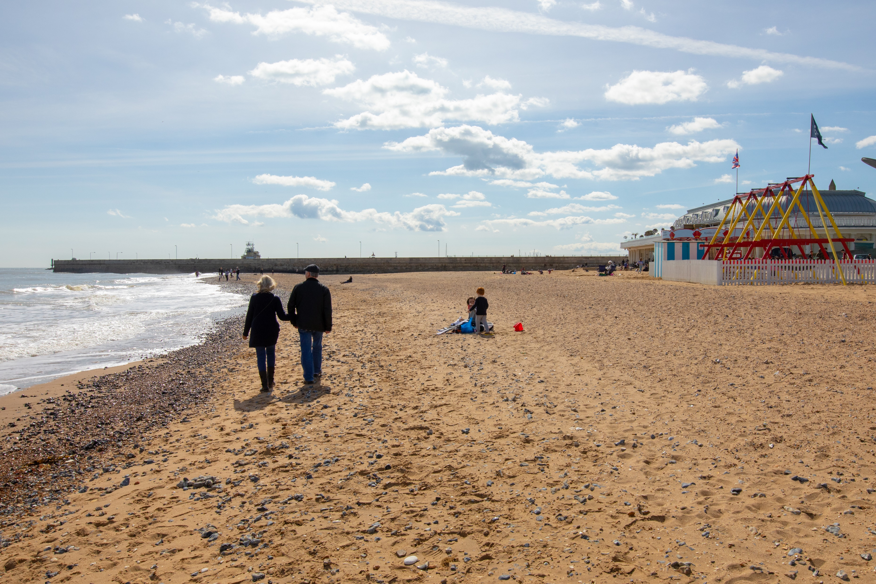
Thanet Visitor Survey – Interpretation and Recommendations
Thanet Visitor Survey - Report of Findings – Introduction
How to connect with visitors to Ramsgate?
WHAT
Recreational activities (water and outdoor sports, walking, cycling, etc.) are likely to trigger visitation. The harbour is perceived as being Ramsgate’s best area, described as being clean and tidy and with good access, being easy to get to and around it. Ramsgate achieved highest scores for the for ‘Traffic levels / congestion’ and ‘Pedestrian signposting’. These are important assets that help promote the area as a nice, clean and friendly place to visit.
Visitors to Ramsgate are more likely to use brochures and leaflets when planning their trips. Once in Ramsgate, they are the most likely not to use any additional types of information, probably because they might rely on details provided by friends and relatives.
CONNECT:
Promote Ramsgate, and in particular the harbour area as a clean and tidy place, with good access and being easy to the to and around it
Consider joint promotion of Broadstairs and Ramsgate as many will visit both locations during their trip
Promote the beach and in particular the harbour area for good places to eat and drink as well as the opportunity for walking and cycling
Ensure a good supply and distribution of leaflets and brochures
Support additional accommodation
Use a tone of voice according to the visitor profile
Credit: Thanet District Council
Page 67

Slide 68
Thanet Visitor Survey - Report of Findings – Appendix 1 – Links to Thanet DMP
Thanet Visitor Survey - Report of Findings – Visitor Profile
Appendix 1
Links to Thanet Destination Management Plan
Page 68

Slide 69
Links to the Thanet DMP
Increase visitor numbers and spend
It is clear that these aims have been achieved, with both volume and value experiencing growth. Since 2013, the number of visitors to Thanet has increased by over 25%, with an overall value increase of 30%. These are incredibly compelling figures, which prove that the regeneration efforts are being recognised and appreciated, with more and more people finding a reason to visit Thanet and its towns.
Investment in culturally-led tourism regeneration and development of the cultural offering and contemporary scene
Margate scored highly in terms of having a range of attractions and things to do, alongside having beautiful beaches. When comparing against the results of the previous perception research study conducted in 2012, there has been a visible shift from the traditional associations with Margate towards a more cultural destination, with ‘opportunities for arts and culture’ ranking fourth. This transition to cultural perceptions support the ambitious goals set out in the DMP to invest in culturally-led tourism regeneration and to further develop the cultural offering and contemporary scene.
Accessibility and strong connectivity
All three towns scored highly in terms of ease of getting to and around the destination, illustrating the areas’ accessibility and strong connectivity. This supports the aim set out in the 2013 DMP, to present the three towns more strongly together and ensure the destination is reachable. This was also highlighted in the primary research, looking at the behaviour of going from one town to another.
Proximity to London
The DMP also highlighted the need to make the most of its location and more importantly its proximity to the capital via high-speed train and the market opportunities it brings. As highlighted in the secondary research findings, off-peak train journeys made to Margate, Broadstairs and Ramsgate, increased by 33% from April 2016 to March 2017 compared to the previous year- showing that visitors are increasingly looking to use this service to visit the area. The extent to which the proximity awareness might also contribute to a stagnation in the volume of overnights should not be ignored either and work should be done to convey that sense of emotional distance.
Page 69

Slide 70
Achieve longer overnight stays and higher spend
As highlighted in the DMP there was a desire to prioritise investment in new quality character accommodation to enable Thanet to grow the short break market and consequently achieve longer stays and higher spend. The results of the 2017 Cambridge Model show that the average length of stay for overnight visits increased by 5.1%, alongside average spend per overnight visit, seeing a 2.2% growth since 2015. That being said, there still is a shortage of quality serviced accommodation that would put the area on the map for tour operators and groups.
Support the growth of the visitor economy the number of jobs created
The fantastic performance recorded by Thanet in the last few years had a significant impact on the number of jobs supported by the visitor economy. Since 2013, jobs have increased by 34%, with employment in the district, in 2017, accounting for 19%.
Greater visitor satisfaction
Increased visitor satisfaction is a key element contributing to the surge in visitation. Previously Thanet attracted negative perceptions linked to the aspect of the towns, lack of entertainment, feeling run-down and old-fashioned. The perception research carried out in 2017 showed significant improvements, also supported by a VisitEngland study that highlighted the Kent coast was driving stronger positive perceptions compared to the overall county average.
The ease of finding your way around the towns achieved the highest score (4.68 out of 5), followed by beach related activities, including the quality of beach experiences (4.56) and beach / coastline cleanliness (4.52). It is significant that beach related activities achieved such high scores taking into account that the coastline and beaches were the main influencer when deciding to visit Thanet.
Page 70

Slide 71
Thanet Visitor Survey - Report of Findings – Appendix 1 - 2010 vs 2018 Results
Thanet Visitor Survey - Report of Findings – Visitor Profile
Appendix 2
Survey Comparisons – 2010 vs 2018 results
Page 71

Slide 72
Thanet Visitor Survey - Report of Findings – Comparisons with 2010 results
Thanet Visitor Survey - Report of Findings – Introduction
Introduction
One of the aims of this study is to measure the changes in visitor numbers, visitor motivations and visitor profile in Thanet since the last face-to-face visitor survey in 2010. This section provides comparisons for some of the key findings between the survey carried out in 2010 and the face to face interviews conducted this year.
In making comparisons between the two reports we have to take into account that the 2010 results are based on a smaller sample (629 interviews compared to 1351 interviews completed in 2018) and is therefore subject to a wider margin of error. The confidence levels for the 2010 report are +3.9% for the Thanet sample and +6.7% for the individual destinations. The confidence levels for the 2018 report are +2.7% for the Thanet sample and +4.6% for the individual destinations.
Origin
The geographical splits are similar for both domestic and overseas visitors. We noticed a higher proportion of visitor from within Kent in the 2010 sample. The proportion of overseas visitors is lower than stated in the Cambridge Model report but, to a certain degree this is also likely to be due to the language barriers during fieldwork.
2010 (Thanet) | Percentage
Kent | 50%
Greater London | 21%
Essex | 5%
Hertfordshire | 2%
Surrey | 2%
Yorkshire | 2%
Scotland | 2%
West Midlands | 2%
ALL UK | 92%
Overseas | 8%
2018 (Thanet) | Percentage
South East | 56%
Kent | 43%
Greater London | 19%
East of England | 13%
East Midlands | 3%
West Midlands | 3%
South West | 2%
Others | 4%
ALL UK | 93%
Overseas | 7%
Page 72

Slide 73
Thanet Visitor Survey - Report of Findings – Comparisons with 2010 results
Thanet Visitor Survey - Report of Findings – Introduction
Type of visitor
The splits between day visitors, touring visitors and visitors staying overnight at the destination have not changed significantly, although we notice a slight increase in the proportion of day visitors from home. This change is consistent with national trends. In terms of purpose of visit, there is an increase in the proportion of leisure and holiday visitors since 2010. We should be mindful of possible differences in sampling strategies at interview stage. However, the higher proportion of visitors from within Kent in the 2010 sample might partially explain the lower proposition of leisure / holiday visitors compared to 2018.
2010 | Thanet | Margate | Broadstairs | Ramsgate
Day visitor from home | 50% | 59% | 37% | 53%
Day visitor on holiday | 23% | 18% | 28% | 21%
Staying visitor | 27% | 22% | 34% | 26%
2018 | Thanet | Margate | Broadstairs | Ramsgate
Day visitors from home | 55% | 55% | 55% | 54%
Day visitors (touring) | 18% | 15% | 19% | 20%
Staying visitors | 27% | 30% | 26% | 26%
2010 | Thanet | Margate | Broadstairs | Ramsgate
Leisure or holiday visit | 79% | 76% | 87% | 73%
Visiting friends or relatives | 13% | 14% | 9% | 15%
Shopping trip (special/non-regular) | 7% | 7% | 2% | 11%
Business/attending conference | 1% | 1% | 1% | -
Language student | 1% | 2% | <1% | <1%
2018 | Thanet | Margate | Broadstairs | Ramsgate
Leisure/Holiday | 94% | 95% | 96% | 91%
Study (Incl. foreign student) | 1% | 1% | 1% | 0%
(Non-regular) Shopping trip | 0% | 0% | 0% | 0%
Visiting friends/relatives | 5% | 4% | 3% | 9%
Page 73

Slide 74
Thanet Visitor Survey - Report of Findings – Comparisons with 2010 results
Thanet Visitor Survey - Report of Findings – Introduction
Age groups and size of visiting party
Overall, we notice a higher proportion of younger adults in the 2018 sample, with age groups 25-34 and 25-44 accounting for 11% and 12% respectively, compared to only 8% and 7% respectively in 2010. The size of visiting groups was smaller in 2018 and included a smaller proportion of children (15% compared to 32% in 2010). The 2010 sample included a larger proportion of students (see overleaf) which could explain the higher proportion of young adults in the sample.
2010 | Thanet | Margate | Broadstairs | Ramsgate
0-15 | 32% | 34% | 43% | 21%
16-24 | 10% | 15% | 8% | 8%
25-34 | 8% | 10% | 7% | 6%
35-44 | 7% | 7% | 5% | 9%
45-54 | 13% | 17% | 9% | 14%
55-64 | 16% | 11% | 15% | 24%
65+ | 13% | 6% | 14% | 18%
2018 | Thanet | Margate | Broadstairs | Ramsgate
0-15 | 15% | 15% | 18% | 13%
16-24 | 7% | 10% | 6% | 5%
25-34 | 11% | 14% | 9% | 11%
35-44 | 12% | 14% | 12% | 9%
45-54 | 15% | 16% | 13% | 16%
55-64 | 16% | 14% | 17% | 18%
65+ | 24% | 17% | 25% | 28%
2010 | Adults | Children under 15 | All people
Margate | 2.11 | 0.64 | 2.85
Broadstairs | 2.46 | 0.86 | 3.33
Ramsgate | 2.02 | 0.31 | 2.33
2018 | Adults | Children under 15 | All people
Margate | 2.25 | 0.40 | 2.65
Broadstairs | 2.23 | 0.48 | 2.71
Ramsgate | 2.31 | 0.34 | 2.65
Secondary Research
Supports the research findings by Visit England (1) about changes in consumer landscape, as markets become ageing societies. – See Secondary Research Report, Page 4.
Page 74

Slide 75
Thanet Visitor Survey - Report of Findings – Comparisons with 2010 results
Thanet Visitor Survey - Report of Findings – Introduction
Employment
Transport
Whilst the car continues to be the main mode of transport, we notice a significant increase in the number of visitors travelling by train. Clearly, the introduction of the high speed rail has had a an impact on the way visitors travel to Kent.
The 2010 sample included a large proportion of students and less adults in retirement. This has resulted in an overall younger sample compared to 2018 (see previous page). Please note the significant demographic trend change since.
2010 | Broadstairs | Ramsgate | Margate
Car/van/motorbike | 66% | 56% | 55%
Bus/coach service | 10% | 19% | 16%
Train | 11% | 10% | 15%
Walked | 9% | 12% | 9%
Boat | 1% | 3% | 0%
Coach tour | <1% | <1% | 1%
Bicycle | 1% | 0% | 3%
2010 | Thanet | Margate | Broadstairs | Ramsgate
Employed full-time | 50% | 56% | 43% | 53%
Employed part-time | 9% | 7% | 15% | 6%
Self-employed | 2% | 2% | 2% | <1%
Retired | 25% | 12% | 28% | 33%
Full-time student living away | 3% | 4% | 3% | 3%
Full-time student living at home | 2% | 3% | 1% | 2%
Unemployed | 9% | 17% | 8% | 2%
2018 | Broadstairs | Ramsgate | Margate
Car / van/motorhome | 54% | 71% | 72%
Train | 30% | 16% | 12%
Coach | 6% | 6% | 3%
Bus | 4% | 3% | 3%
Ferry | 0% | 0% | 0%
Boat (Yacht, etc.) | 0% | 0% | 2%
Bike | 1% | 0% | 1%
Other | 5% | 4% | 6%
2018 | Thanet | Margate | Broadstairs | Ramsgate
Employed full-time (30+ hrs / week) | 51% | 56% | 50% | 47%
Employed part-time (up to 29 hrs / week) | 6% | 9% | 4% | 6%
Self-employed | 7% | 8% | 7% | 6%
Retired | 31% | 21% | 35% | 37%
Full-time student living at home | 1% | 2% | 1% | 0%
Full -time student living away | 1% | 2% | 0% | 0%
Unemployed | 3% | 3% | 2% | 3%
Secondary Research
Looking at the figures of train journeys made to Margate, Broadstairs and Ramsgate, journeys on Off-Peak products increased by 33% from April 2016 to March 2017. – See Secondary Research Report, Page 21.
Page 75

Slide 76
Thanet Visitor Survey - Report of Findings – Comparisons with 2010 results
Thanet Visitor Survey - Report of Findings – Introduction
Accommodation used
The 2010 sample includes a larger proportion of people staying with friends and relatives. This is to be expected given the sample composition and in particular the purpose of the visits. With a larger proportion of visitors on a leisure holiday trip during 2018, it is not surprising that the percentage of those in paid accommodation is also higher. The other key difference is the increase in the use of self catering accommodation and clearly, the emergence of OTAs such as Airbnb will have paid a role in this increase.
2010 | Thanet | Margate | Broadstairs | Ramsgate
Home of friend or relative | 47% | 51% | 40% | 51%
Hotel | 17% | 21% | 19% | 9%
Rented self catering accommodation | 10% | 2% | 19% | 6%
Host family | 6% | 6% | 8% | 4%
Second home | 6% | 4% | 6% | 8%
B&B/Guest house | 5% | 4% | 4% | 6%
Boat/Yacht | 3% | - | - | 11%
Static caravan – owned | 2% | 4% | - | 4%
Touring caravan / Camping | 2% | 2% | 3% | -
Youth hostel | 1% | 2% | - | -
Other | 1% | 2% | - | 2%
2018 | Thanet | Margate | Broadstairs | Ramsgate
Friends and Relatives | 29% | 27% | 25% | 34%
Hotel | 26% | 29% | 25% | 25%
Rented Self-catering accommodation | 14% | 10% | 18% | 14%
Airbnb | 9% | 16% | 7% | 4%
Other | 8% | 3% | 11% | 10%
Bed and Breakfast/Guest house | 7% | 10% | 8% | 5%
Touring caravan / Camping | 6% | 5% | 7% | 7%
Page 76

Slide 77
Thanet Visitor Survey - Report of Findings – Comparisons with 2010 results
Thanet Visitor Survey - Report of Findings – Introduction
Expenditure
As you would expect, expenditure levels have gone up since 2010 even when inflation is taken into account. However, we notice an increase in the proportion of day visitor spend on entertainment. This is particularly visible in Margate and likely to be linked to the presence of Turner Contemporary and Dreamland and the wider regeneration mission undertaken. Similarly, overnight trip spend has increased and we notice an increase in the proportion of expenditure on eating and drinking, in line with current trend changes.
Day visitors Day visitors
2010 | Thanet | Margate | Broadstairs | Ramsgate
Eating and drinking | £6.73 | £5.68 | £7.08 | £7.90
Shopping | £3.43 | £3.37 | £1.07 | £5.24
Entertainment | £0.55 | £0.75 | £0.51 | £0.32
Travel & transport | £1.79 | £2.24 | £1.79 | £1.20
Total | £12.50 | £12.04 | £10.45 | £14.66
Total (with inflation) | £15.74 | £15.15 | £13.25 | £18.36
2018 | Thanet | Margate | Broadstairs | Ramsgate
Eating and drinking | £12.15 | £11.99 | £14.01 | £10.27
Shopping | £3.20 | £3.79 | £3.17 | £2.60
Entertainment | £2.26 | £4.27 | £1.05 | £1.35
Travel & transport | £7.10 | £8.49 | £6.93 | £5.05
Spend per day trip | £24.71 | £28.53 | £25.16 | £19.27
Overnight visitors Overnight visitors
2010 | Thanet | Margate | Broadstairs | Ramsgate
Eating and drinking | £10.50 | £11.71 | £10.12 | £10.18
Shopping | £5.92 | £8.51 | £5.44 | £4.83
Entertainment | £1.55 | £2.71 | £1.67 | £0.63
Travel & transport | £1.02 | £1.12 | £0.45 | £1.69
All accommodation | £9.53 | £8.53 | £11.09 | £6.62
Total | £28.52 | £32.58 | £28.77 | £23.95
Total (with inflation) | £35.90 | £40.94 | £36.53 | £30.23
2018 | Thanet | Margate | Broadstairs | Ramsgate
Eating and drinking | £14.66 | £15.80 | £13.97 | £14.22
Shopping | £4.04 | £4.03 | £5.48 | £2.62
Entertainment | £3.97 | £7.21 | £3.08 | £1.63
Travel & transport | £7.05 | £8.74 | £4.83 | £7.60
All accommodation | £14.23 | £14.85 | £15.93 | £11.93
Spend per night | £43.97 | £50.63 | £43.28 | £37.99
Secondary Research
Supports Visit England’s view that England has seen significant growth, with record tourist spending reported in recent years from both domestic and international markets. – See Secondary Research Report, Page 4.
Note: We have used the Bank of England inflation calculator to check how expenditure levels have changed between 2010 and 2018
Page 77

Slide 78
Thanet Visitor Survey - Report of Findings – Comparisons with 2010 results
Thanet Visitor Survey - Report of Findings – Introduction
Information and marketing
There’s been a marked increase in the proportion of visitors using some type of marketing material as part of their decision making process when choosing their visitor destination. In particular, the use of destination websites has increased – arguably, the digital advancements have been revolutionary – i.e. rise of social media, continual increase in online booking behaviour. Combined, destination websites, other websites / search engine and review websites (TripAdvisor etc.) accounted for 25% of all marketing consumption, up from 7% in 2010. Recommendations have become more important and printed brochures still have a sizable ‘market’, particularly across an older demographic.
2018 | Thanet | Margate | Broadstairs | Ramsgate
I did not use any information | 62% | 57% | 63% | 66%
Advertisement (Paper / Magazine/ TV / radio) | 2% | 3% | 1% | 1%
I visited the destination website | 12% | 12% | 14% | 10%
I visited other websites / search engine | 10% | 12% | 10% | 9%
I visited review websites (TripAdvisor etc) | 3% | 4% | 3% | 4%
I looked through Location brochures / leaflets | 8% | 4% | 8% | 10%
I looked for recommendations on social media | 2% | 3% | 3% | 1%
I asked friends for recommendations | 7% | 9% | 6% | 5%
Other | 5% | 7% | 5% | 2%
2010 | Thanet | Margate | Broadstairs | Ramsgate
Did not use any information | 85% | 78% | 85% | 90%
Website | 7% | 9% | 9% | 2%
Brochure | 4% | 6% | 4% | 3%
Friends/relatives | 3% | 4% | 4% | 2%
Advertisement | 1% | 2% | - | -
Guide book about the area | 1% | 1% | <1% | 1%
TIC/VIC at destination | <1% | <1% | - | -
Other | 1% | 1% | <1% | 2%
Page 78

Slide 79
Thanet Visitor Survey - Report of Findings – Comparisons with 2010 results
Thanet Visitor Survey - Report of Findings – Introduction
Overall enjoyment and likelihood of recommending
The levels of satisfaction and motivation to visit have seen the most significant increases. Scores for the overall enjoyment with visits has increased in all destinations and as a result, the mean score for the district has gone up from 3.77 in 2010 to 4.36 in 2018. Similarly, the likelihood of recommending is also higher than in 2010, although the differences are not so substantial as with the scores for overall enjoyment – the district average has increase from 4.04 in 2010 to 4.32 in 2018.
Overall enjoyment Likelihood of recommending
2010 | Thanet | Margate | Broadstairs | Ramsgate
Very high | 22% | 8% | 43% | 15%
High | 42% | 38% | 43% | 43%
Average | 29% | 42% | 11% | 35%
Low | 6% | 10% | 1% | 7%
Very low | 1% | 3% | 1% | -
Mean score | 3.77 | 3.38 | 4.26 | 3.66
2010 | Thanet | Margate | Broadstairs | Ramsgate
Very likely | 50% | 27% | 79% | 41%
Likely | 23% | 23% | 13% | 33%
Possibly | 15% | 24% | 5% | 16%
Unlikely | 8% | 17% | 1% | 6%
Very unlikely | 5% | 9% | 1% | 5%
Don't know | 0% | 0% | 0% | 0%
Mean score | 4.04 | 3.41 | 4.68 | 4.01
2018 | Thanet | Margate | Broadstairs | Ramsgate
Very high | 44% | 41% | 55% | 37%
High | 49% | 47% | 43% | 56%
Average | 6% | 10% | 2% | 6%
Low | 1% | 2% | 0% | 1%
Very low | 0% | 0% | 0% | 0%
Mean score | 4.36 | 4.27 | 4.53 | 4.29
2018 | Thanet | Margate | Broadstairs | Ramsgate
Very likely | 53% | 48% | 67% | 46%
Likely | 36% | 38% | 29% | 41%
Average | 6% | 9% | 3% | 7%
Unlikely | 2% | 3% | 0% | 3%
Very unlikely | 1% | 1% | 0% | 0%
Don't know | 2% | 1% | 1% | 2%
Mean score | 4.32 | 4.26 | 4.60 | 4.21
Page 79

Slide 80
This research report has been produced by:
Produced for:
Raluca Brebeanu
Head of Research
VISIT KENT
Tel: 01227 812917
raluca.brebeanu@visitkent.co.uk
www. visitkent.co.uk
Sergi Jarques
Director
Destination Research Ltd
Tel: 01206 392528
sergi@destinationresearch.co.uk
www.destinationresearch.co.uk

